Slide 1
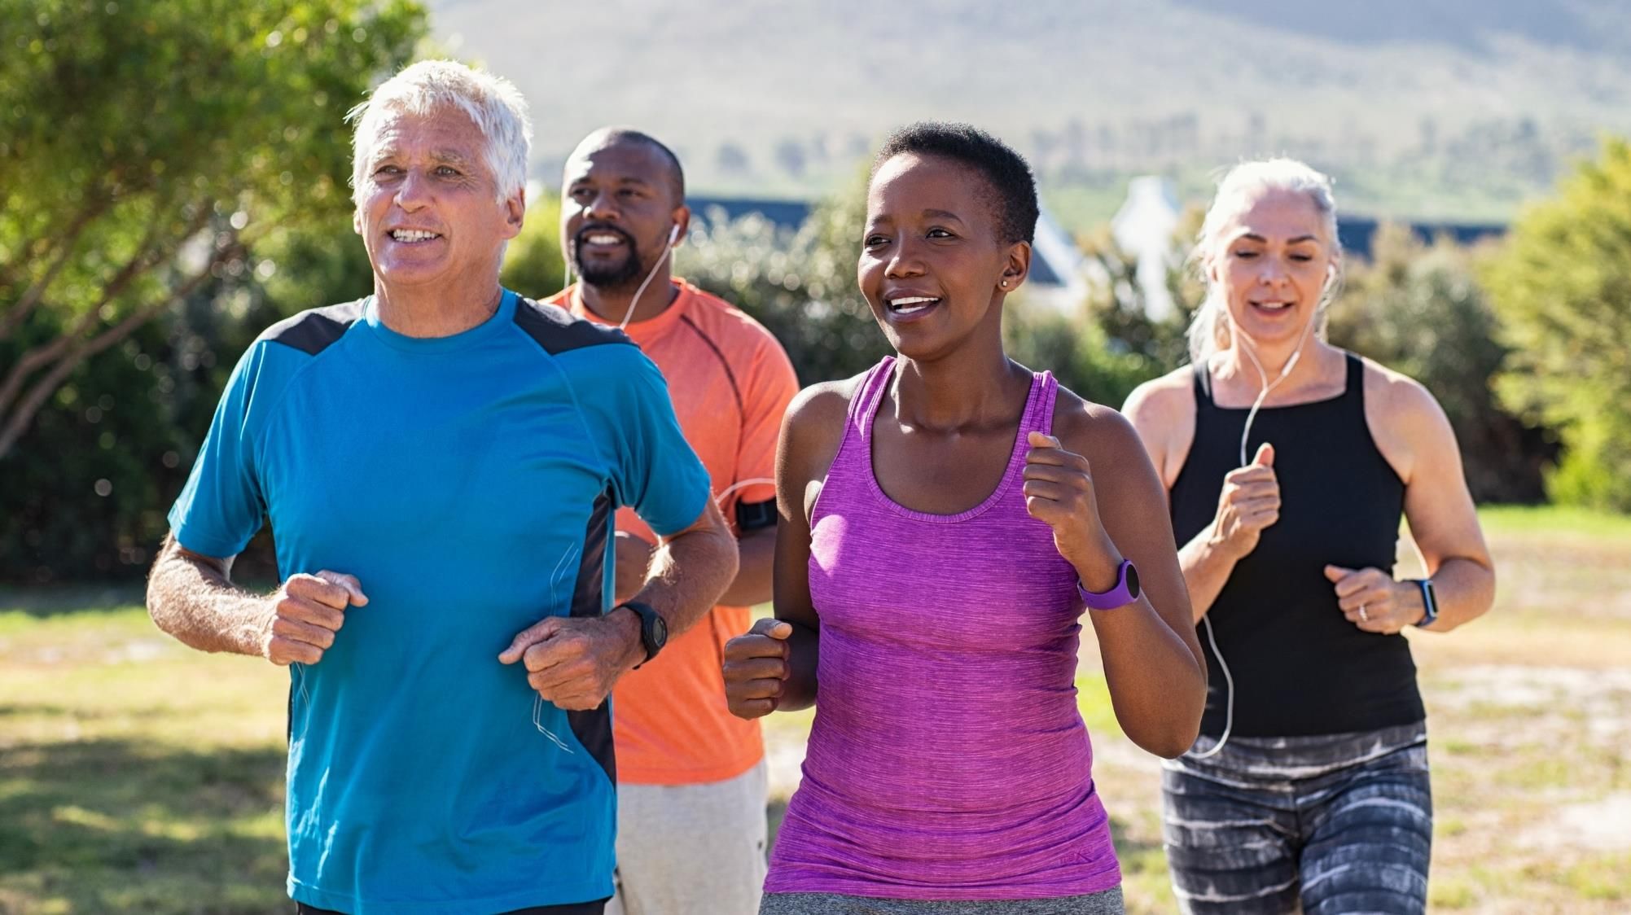
The Foundational Components of Lifestyle Medicine: Exercise, Nutrition and Sleep
Notes:
Welcome to The Foundational Components of Lifestyle Medicine: Exercise, Nutrition and Sleep.

Slide 2
DEVELOPED BY
JENNIFER L. TRILK, PhD, FACSM, DipACLM
Associate Professor, Dept. of Biomedical Sciences
University of South Carolina School of Medicine Greenville

Slide 3
Session Topics
Movement Definitions, the FITT Principle and Exercise Prescription
1
Measure of Cardiorespiratory Fitness and Overall Health
Exercise is Medicine statistics
Introduction to VO2 Max
2
Nutritional Information: More than Protein, Carbs and Fats
3
Review and Discussion of goals and challenges
4

Slide 4
OBJECTIVES
Describe the characteristics of a healthy diet and a physically active lifestyle.
1
Review your LM Goals from IPM 1 (“Intro to LM”) and self-evaluate your current behaviors compared to your goals.
2
Utilize your chosen App tracker to complete your nutritional assessment and evaluate your nutrition behavior and rate your stage of change; set measurable goals for improvement.
3
Evaluate your exercise behavior and rate your stage of change; use the FITT principle to set measurable goals for improvement.
4

Slide 5
The Paradox…..
“Let food be thy medicine and medicine be thy food.” Hippocrates
“Lack of activity destroys the good condition of every human being, while movement and methodical physical exercise save it and preserve it.” Plato
So how did the human race get into the current situation?
The World Health Organization stated that by 2020, two-thirds of global disease will be the result of lifestyle behaviors such as poor diet, a physically inactive lifestyle, and high stress levels.¹
Notes:
The Paradox…..
Hippocrates and Plato, both living in the times of 400 to 300 BC, had it right.
Why are we in this paradox of this current situation?
World Health Organization, saying that by 2020 most disease will be related to our lifestyle behaviors.
A lot of the patients that you're going to see are going to be based on lifestyle behaviors. How do we work with that?

Slide 6
?
Ice Breaker Question 1
Rank, in order from highest risk to lowest risk, these workers’ risks of cardiovascular disease based on their occupation:
Bicycle courier, Bus driver, Walmart greeter
Walmart greeter, Bicycle courier, Bus driver
Bus driver, Bicycle courier, Walmart greeter
Bus driver, Walmart greeter, Bicycle courier

Slide 7
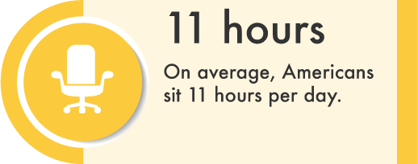
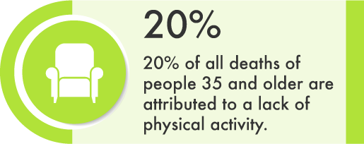
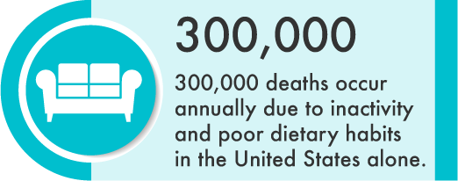
Physical Inactivity Facts
One of the leading risk factors for death worldwide
Key risk factor for noncommunicable diseases (NCDs) such as cardiovascular diseases, cancer and diabetes
Globally, 1 in 4 adults is not active enough
More than 80% of the world's adolescents are not physically active enough
www.lifespanfitness.com
www.ncpad.org www.suite101.com www.naturalnews.com www.hopkinsmedicine.org
https://www.who.int/en/news-room/fact-sheets/detail/physical-activity
Notes:
Physical Inactivity Facts
“Sitting is the new smoking.” Everyone struggles with sitting too much (11 hours per day), which is a strong contributor to chronic disease.
Children and youth are not getting the physical activity they need for development and strength building in bone building.
Physical activity has significant health benefits and contributes to prevent NCDs.
WHO's Global Action Plan for the Prevention and Control of NCDs 2013-2020. The plan calls for a 10% reduction in physical inactivity by 2025, which contributes to achieving the Sustainable Development Goals (SDGs).

Slide 8
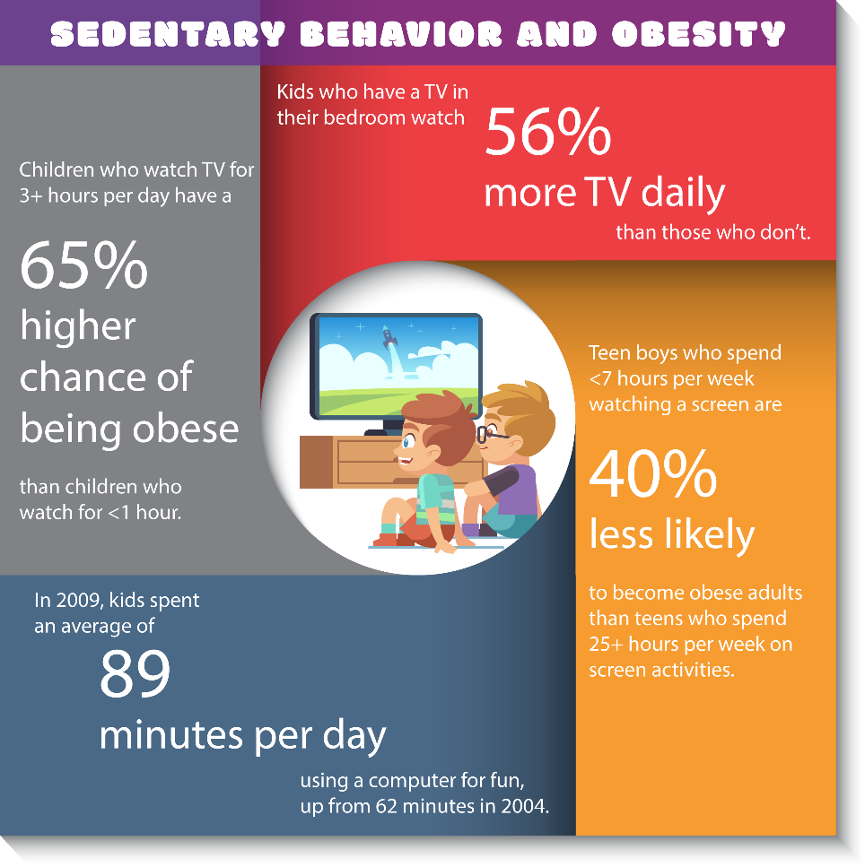
Physical Inactivity Contributors
Behavioral:
Inaction during leisure time (TV or computer)
Sedentary behavior on the job and at home
“Passive” models of transportation
Environmental (linked to urbanization):
Fear of violence and crime in outdoor areas
High-density traffic
Low air quality, pollution
Lack of parks, sidewalks/sports/recreation facilities
https://www.who.int/en/news-room/fact-sheets/detail/physical-activity
Notes:
Physical Inactivity Contributors
TV, Computer, sedentary job at home, passive modes of transportation.
Unsafe outdoor environment (no sidewalks/pedestrian areas, lack of green space, unsafe neighborhoods, crime, etc.}

Slide 9
Sitting Facts
The estimated gains in life expectancy in the US population were 2.00 years for reducing excessive sitting to <3 h/day
Katzmarzyk PT, Lee I-M. Sedentary behavior and life expectancy in the USA: a cause-deleted life table analysis. BMJ Open 2012;2:e000828. doi:10.1136/bmjopen-2012-000828
Notes:
Sitting Facts
Katzmarzyk et al. 2012: sitting for more than three hours a day increases risk of living 2 years less. , you're potentially going to live to years less so if you sit for more than three hours a day
Break up your sitting durations. Stand up and walk, get water, walk around the building, etc.

Slide 10
Sitting Facts
©2009The American College of Sports Medicine. Published by Lippincott Williams & Wilkins, Inc.
Katzmarzyk, Peter; Church, Timothy; Craig, Cora; Bouchard, Claude
Medicine & Science in Sports & Exercise. 41(5):998-1005, May 2009.
Link to Study
Notes:
Sitting Facts
Cumulative survival rate reduces significantly for individuals who sit almost none of the time versus individuals who sit almost all of the time.
Studied in 17,000 men and women over 14 years.

Slide 11
How Fast Does the Grim Reaper Walk? (Receiver operating characteristics curve analysis in healthy men aged 70 and over)
Participants: 1705 men aged 70 or more participating in CHAMP (Concord Health and Ageing in Men Project)
Main outcome measures: Walking speed (mph) and mortality
Results: Older men who walked faster than 2 mph were 1.23x less likely to die than those who walked slower (P=0.0003)
Conclusion: The Grim Reaper’s preferred walking speed is 2 mph under working conditions.
None of the men in the study with walking speeds ≥3 mph had contact with Death
(this seems to be the Grim Reaper’s most likely maximum speed)
For those wishing to avoid this fate, walking ≥3 mph is advised ☺
Link to Study
Notes:
How Fast Does the Grim Reaper Walk? (Receiver operating characteristics curve analysis in healthy men aged 70 and over)
Older men who walked faster than two MPH were 1.23 times less likely to die than those who walked slower with his statistically significant P value.
Conclusion was the “Grim Reaper’s” preferred walking speed is about two MPH under normal working conditions.
Men who walked more than 3 MPH had contact with death during follow up; they were able to “out walk” him.

Slide 12
?
Ice Breaker Question 2
What are the United States and World Health Organization Recommendations on Physical Activity for Health Promotion and Chronic Disease Risk Reduction for Adults?
At least 30 minutes/week of moderate-to-vigorous PA
At least 60 minutes/week of moderate-to-vigorous PA
At least 120 minutes/week of moderate-to-vigorous PA
At least 150 minutes/week of moderate-to-vigorous PA

Slide 13
Scientific evidence for benefits of Exercise/Physical Activity
Active 80-year-olds have lower risk of death than inactive 60-year-olds
Reduces mortality and the risk of recurrent breast cancer by
Lowers the risk of colon cancer by over
Reduces the risk of developing of Alzheimer’s disease by
Reduces incidence of heart disease and high blood pressure by
Lowers the risk of stroke by 27%
Lowers the risk of developing type II diabetes (T2D) by
Is twice as effective in treating T2D than the standard insulin prescription
Saves type 2 diabetics per person per year when compared to cost of standard drug treatment
Decreases depression as effectively as Prozac or behavioral therapy
~50%
~60%
~40%
~50%
~58%
$2250
https://www.exerciseismedicine.org/assets/page_documents/EIM%20Fact%20Sheet.pdf
Notes:
Scientific evidence for benefits of Exercise/Physical Activity
The PA guidelines from the World Health Organization, the CDC, and in the American College of Sports Medicine.
Compiled data from the EIM fact sheet referenced here.

Slide 14
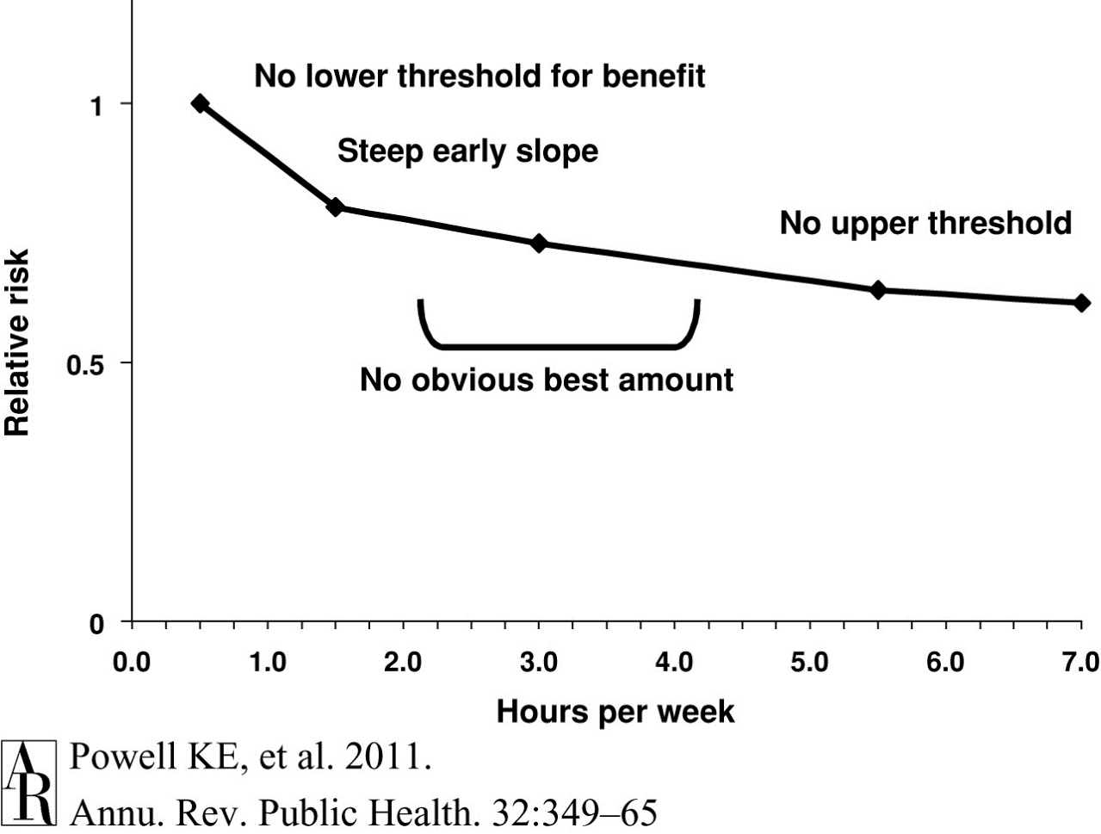
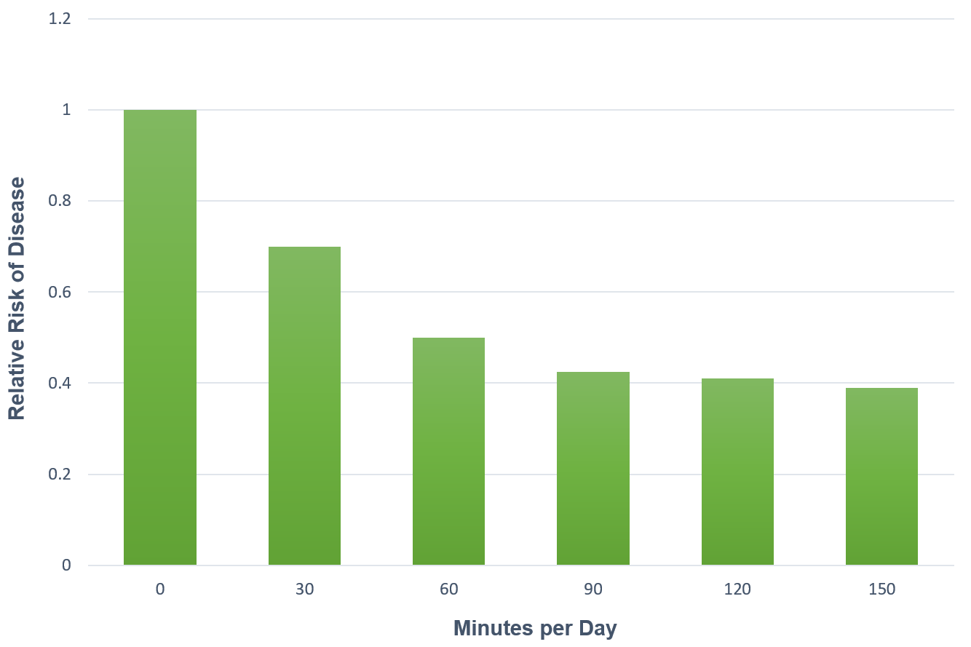
Exercise Benefits
Study Link
Study Link
Amount of Exercise vs. Risk of Disease
Notes:
Exercise Benefits
Research by Ken Powell and Stephen Blair looks at exercise benefits related to relative risk of chronic disease in quantiles of hours per week or minutes per day.
Significant risk reduction from zero physical activity to getting started at least 1 hour per week or 30 minutes per day.
Transitioning from a sedentary state to being a little bit more physically active improves health.
Curvilinear relationship with no additional significant benefits beyond a certain threshold.
Clinical relevance: what can you do to get your patient even a little physically active?

Slide 15
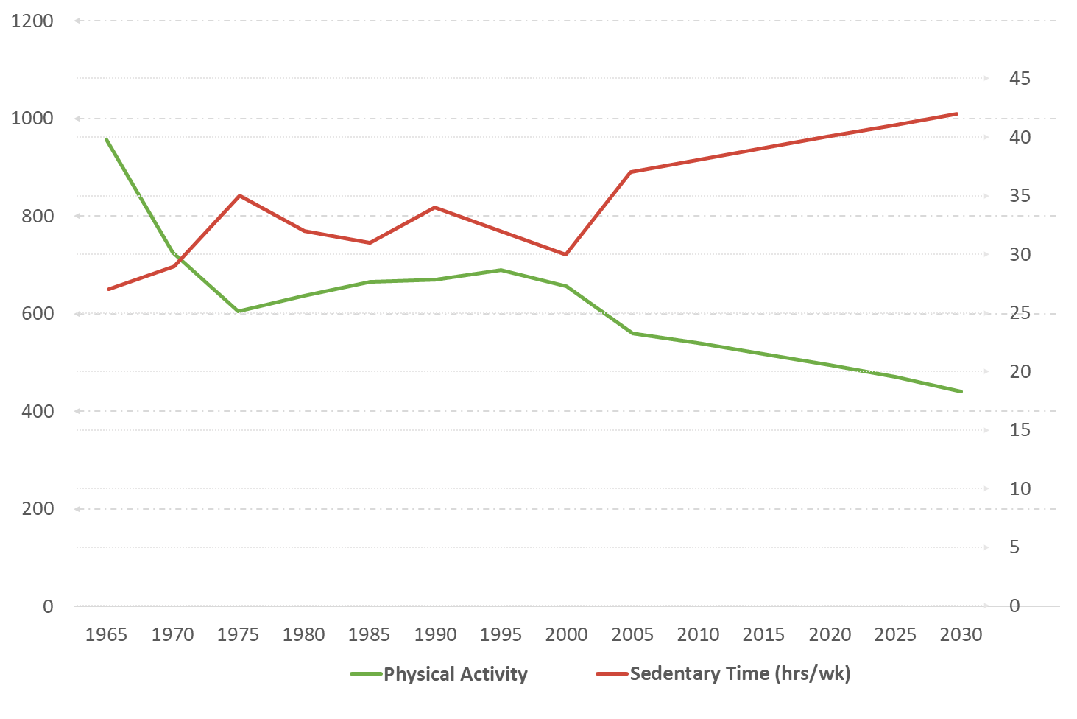
Exercise Benefits
Physical Activity vs. Sedentary
Ng & Popkin Obes Rev. 2012 Aug; 13(8): 659-680
Us Adults MET-hours Per Week of All Physical Activity, and Hours/Week of Time in Sedentary Behavior: Measured for 1965-2009, Forecasted for 2010-2030
Source: Multinational Time Use Studies v5.52(1965, 1975, 1998) v5.8(1985, 1992,1995), and American Time Use Survey 2003-2009; Applying Compendium of Physical Activity MET-intensity values based on reported time spent across 41 MTUS coded activities and by occupation. Forecasting for 2010-2030 based on 2003-2009 slopes.
Average hours per week being sedentary
Average MET-hours per week
extrapolated
Time Use and Physical Activity
Notes:
Exercise Benefits
Ng and Popkin 2012 demonstrated that as we've become an industrialized and technological society, all physical activities (leisure time, occupational time, transportation time, etc.) have declined while sedentary behavior has increased.

Slide 16
U.S. Physical Activity Report Card 2018
www/cdc.gov
U.S. Physical Activity Data on PA from CDC
2018 demonstrated than only 54% of adults get the recommended amount of physical activity
Men are more active than women
Older adults are less likely to meet PA guidelines than youth (sedentary work, etc.)
Americans in the South are the least active.
Notes:
U.S. Physical Activity Data on PA from CDC
2018 demonstrated than only 54% of adults get the recommended amount of physical activity
Men are more active than women
Older adults are less likely to meet PA guidelines than youth (sedentary work, etc)
Americans in the South are the least active.
This CDC tool https://nccd.cdc.gov/dnpao_dtm/rdPage.aspx?rdReport=DNPAO_DTM.ExploreByLocation&rdRequestForwarding=Form demonstrates in detail if you wish to explore your own state.

Slide 17
Definitions of Movement
Physical activity (PA):
Any bodily movement produced by skeletal muscles that increases energy expenditure (gardening, walking/cycling for transport, manual labor)
Exercise:
Planned and structured repetitive movements designed specifically to improve fitness and health
Sport:
Physical activity which involves structured competitive situations governed by rules
Physical fitness:
A set of attributes such as stamina, mobility, and strength that relate to ability to perform physical activity
Cardiorespiratory fitness:
The ability of the body's circulatory and respiratory systems to supply fuel and oxygen during sustained physical activity.
Notes:
Definitions of Movement
Understanding the terminology of physical activity as a clinician is important for helping your patient achieve goals.
Very important to be aware of one’s physical activity behavior throughout the day.
Clear operational differences between PA, Exercise, Sport, Physical Fitness, and Cardiorespiratory Fitness.
All (PA, Exercise, and Sport) contribute to improving health and decreasing risk of chronic disease
Cardiorespiratory fitness is the body's circulatory in respiratory system to supply fuel on oxygen to sustain physical activity.
Clinical examples:
Physical fitness: are patients able to live and function on their own based on their muscle strength and mobility? Are cancer survivors able to overcome chemotherapy-related fatigue?,
Skeletal muscle is responsible for approximately 80% of global of glucose disposal by the body, so it can reduce blood glucose levels in type two diabetics
Increases contraction-mediated GLUT-4 translocation to the muscle cell surface during exercise to take in glucose.
Increases insulin sensitivity after exercise.

Slide 18
The F.I.T.T Principle (or what you would use as your exercise prescription)
The F.I.T.T. Principle is one of the foundations of exercise, a set of guidelines that help you set up a workout routine to fit your goals and fitness level while helping you get the most out of your exercise.
F: Frequency
I: Intensity
T: Time
T: Type
https://bjgp.org/content/64/618/12.full
Notes:
The F.I.T.T Principle (or what you would use as your exercise prescription)
What is the exercise prescription? How do you counsel your patients to become physically active?
The FITT principal has been around for 50 plus years, and it's frequency, intensity, time and type.
It is the foundation of the exercise prescription.
Helps to break down the US PA guidelines of 150 minutes per week of moderate-intensity PA.

Slide 19
The F.I.T.T Principle
Frequency: How often you exercise.
For Cardio Exercise: Exercise Guidelines suggest moderate exercise five or more days a week or intense cardio three days a week to improve your health. For weight loss, you may need to do up to six or more days a week.
For Strength Training: Exercise Guidelines recommend that frequency is 2-3 non-consecutive days a week (at least 1-2 days between muscle groups).
Notes:
The F.I.T.T Principle: Frequency
How often to exercise? How many days per week? Targeting the Cardiorespiratory System, the Metabolic System, and the Musculoskeletal System.
If the guidelines are 150 minutes per week of aerobic activity, it is common to suggest 5 days per week at 30 minutes a day (which is time).
For weight loss, you need to do at least six or more days a week.
Strength training is recommended at a minimum of 2 to 3 non-consecutive days a week for each muscle group, with at least 1 to 2 days between muscle groups.
Goal is to improve skeletal muscle quality and quantity.

Slide 20
The F.I.T.T Principle
Intensity: How hard you work during exercise
For Cardio Exercise: The general rule is to work in your target heart rate zone and focus on a variety of intensities to stimulate different energy systems.
For Strength Training: The exercises you do (at least 8-10 exercises), the amount of weight you lift and your reps and sets determine the intensity of your strength workouts. In general, you want to lift enough weight that you can only complete the desired number of reps (around 1-3 sets of 8-16 reps of each exercise).
Notes:
The F.I.T.T Principle: Intensity
How hard to exercise?
Be able to define the difference between moderate and intense physical activity.
Clinical application-if you were to discuss this with the patient:
Light physical activity: any movement that takes you from a sedentary state to bodily movement.
Moderate physical activity: a brisk walk to where he/she can talk to his/her neighbor but can't sing.
Intense physical activity: a run or stationary bike where the effort is difficult enough to not be able to talk or sing while exercising.
Strength training example: The amount of weight that is used to strength train.
Moderate-intense physical activity is anywhere between 12 and 15 reps.
Intense PA is about 8 to 10 reps.
Progression is key to adaptation without injury.

Slide 21
The F.I.T.T Principle
Time: How long you exercise
For Cardio Exercise: The exercise guidelines suggest 30-60 minutes of cardio (or working your way up to that). How long you exercise will not just be dependent on your fitness level, but also your intensity. The harder you work, the shorter your workouts will be.
For Strength Training: The exercise guidelines for how long you lift weights depends on the type of workout you're doing and your schedule. For example, a total body workout could take up to an hour, whereas a split routine could take less time.
Notes:
The F.I.T.T Principle: Time
How long to exercise?
Cardio exercise suggest 30 to 60 minutes of cardio a day.
Strength training depends on the type of workout: Total body vs. muscle groups can last between 15 minutes and 1 hour.
Clinical application: you doing for your scheduled total body workout. Total body workout could take an hour if you're doing a muscle group of particular muscle group. You could be in there 15 to 30 minutes. I
Clinical application-It's going to be dependent upon the patient’s ability and current conditioning.
Average health seeking patient may be able to do a brisk walk for 30 minutes outside.
More sick patients or deconditioned patients (i.e., cardiac rehab or oncology rehab) may start at five minutes before they're fatigued.
Take home is to start at the patient’s level and progress successfully to the 30 minutes per day for optimal success in behavior change.

Slide 22
The F.I.T.T Principle
Type: The type of activity you're doing
For Cardio Exercise: Any activity that gets your heart rate up counts as cardio - Running, walking, cycling, dancing, sports, etc.
For Strength Training: This pretty much includes any exercise where you're using some type of resistance (bands, dumbbells, machines, etc.) to work your muscles. Bodyweight exercises can also be considered a form of strength training, as well, although building strength will likely require more resistance.
Notes:
The F.I.T.T Principle: Type
What kind of exercise?
KEY: ENJOYMENT
Examples: Walk, stationary bike, dancing.

Slide 23
The F.I.T.T Principle
Why is the F.I.T.T. Principle important?
Helps to go beyond plateaus
Helps body adapt to be in better shape
After a few weeks, body adapts to these workouts and several things may happen:
Your body becomes more efficient at exercise - The more you work out, the easier it is to do the exercises, causing you to burn fewer calories than you did when you started.
Weight loss - Your new workouts may cause weight loss which, of course, is a good thing. The downside? You expends fewer calories moving that new, more efficient body around.
Boredom - Doing the same workout for weeks or months on end can get old, eating into your motivation to exercise.
How can you manipulate one or more of the F.I.T.T. Principles?
F:Frequency?
I: Intensity?
T: Time?
T: Type?
Notes:
The F.I.T.T Principle: Summary
Helps clinician provide the exercise prescription.
Helps the patient learn how to adapt and overcome plateaus in becoming conditioned and healthier.
Helps in reduction of boredom
Helps give a more specific and measurable goal.

Slide 24
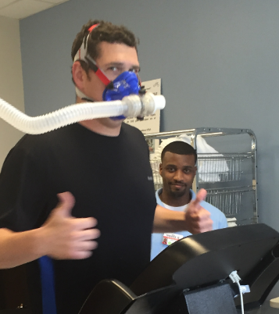
?
Practice Question 1
Indicator of cardiorespiratory fitness
Predictor of performance of endurance sports athletes
Indicator of an individual's body to maximally transport and use oxygen during exercise
Predictor of mortality from all causes, cardiovascular disease, and cancer
All the above
How Important is VO₂max?
What Does Yours Actually Mean?
Notes:
Practice Question 1
Lead way into the importance of cardiorespiratory fitness and maximal cardiorespiratory fitness as a measure of health and fitness.

Slide 25
Definitions of Movement
Physical activity (PA):
Any bodily movement produced by skeletal muscles that increases energy expenditure (gardening, walking/cycling for transport, manual labor)
Exercise:
Planned and structured repetitive movements designed specifically to improve fitness and health
Sport:
Physical activity which involves structured competitive situations governed by rules
Physical fitness:
A set of attributes such as stamina, mobility, and strength that relate to ability to perform physical activity
Cardiorespiratory fitness:
The ability of the body's circulatory and respiratory systems to supply fuel and oxygen during sustained physical activity.
VO₂max:
The MAXIMAL ability of the circulatory and respiratory systems to supply oxygen to working skeletal muscle, as well as maximal ability of skeletal muscle to uptake oxygen during maximal exercise.
Notes:
Definitions of Movement: VO2max
The maximal ability of the circulatory and respiratory system to supply oxygen to working skeletal muscle, as well as maximally ability of skeletal muscle to uptake oxygen and use substrates as fuel to create ATP during maximal exercise.

Slide 26
VO2max
Maximum rate at which an individual can consume O₂ during maximal exertion.
Expressed as the maximum volume of oxygen consumed/min
Absolute: liters per min (L/min)
Relative: milliliters per kilogram per minute (ml/kg/min)
1 MET = metabolic equivalent = A unit used to estimate the metabolic cost oxygen consumption) of physical activity = 3.6 ml O₂/kg/min
Notes:
VO2max
Maximal cardiorespiratory fitness is expressed is either absolute in liters per minute or in relative milliliters per kilogram of body weight per minute.
ml/kg/min is primarily used to normalize men and women and compare fitness across different body weights and sizes.
Metabolic Equivalents (METS): 1 MET (resting value) is approximately 3.6 ml/kg/min
Rest: 1 MET
LPA: 1-3 METS
MPA: 3-6 METS
VPA: 6+ METS

Slide 27
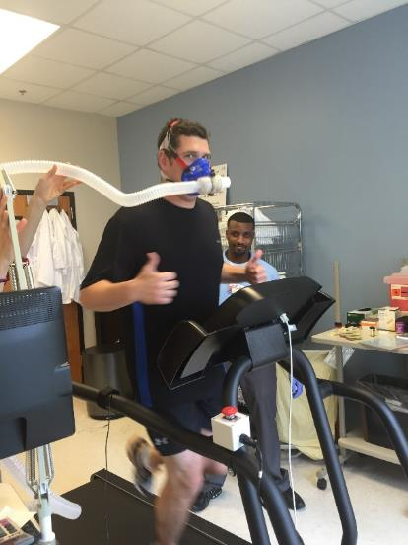
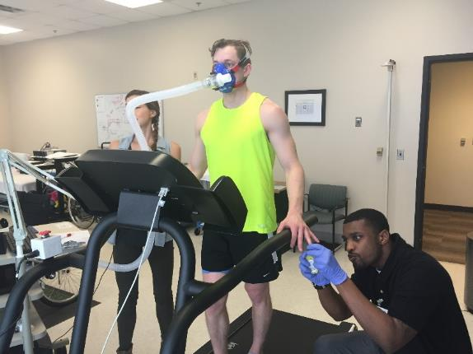
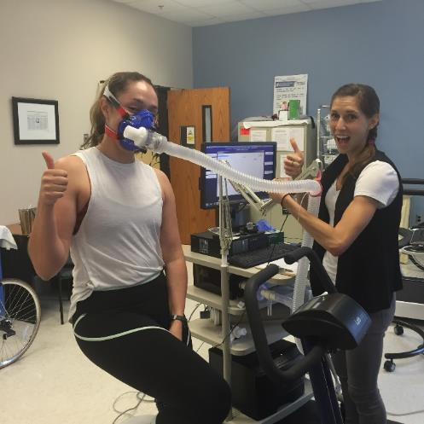
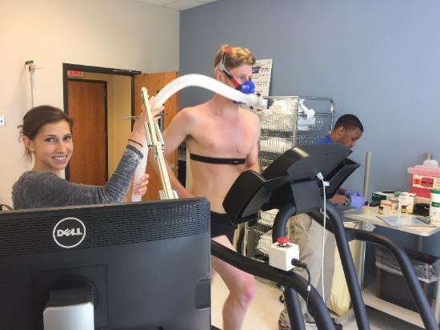
VO₂max: The Fick Principle
VO₂max = Q x (a-v)O₂diff
“Fick Principle”
Notes:
VO2 Max: The Fick Principle
Step 1 Material
VO2max = Cardiac Output x arterio-venous oxygen difference

Slide 28
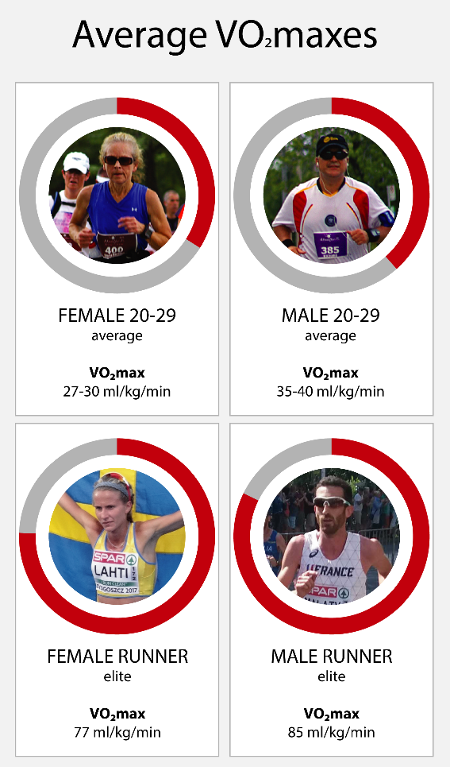
ACSM VO₂max Chart
Male VO₂max (mL O2 • kg⁻¹• min⁻¹)
Age | Superior | Excellent | Good | Fair | Poor | Very Poor
20-29 | 66.3 | 57.1 - 61.8 | 50.2 - 55.2 | 44.9 - 49.0 | 38.1 - 43.5 | 29.0 - 35.4
30-39 | 59.8 | 51.6 - 56.5 | 45.2 - 49.2 | 39.6 - 43.8 | 34.1 - 38.5 | 27.2 - 32.7
40-49 | 55.6 | 46.7 - 52.1 | 40.3 - 45.0 | 35.7 - 38.9 | 30.5 - 34.6 | 24.2 - 29.0
50-59 | 50.7 | 41.2 - 45.6 | 35.1 - 39.7 | 30.7 - 33.8 | 26.1 - 29.5 | 20.9 - 24.4
60-69 | 43.0 | 36.1 - 40.3 | 30.5 - 34.5 | 26.6 - 29.1 | 22.4 - 25.7 | 17.4 - 21.2
Female VO₂max (mL O2 • kg⁻¹• min⁻¹)
Age | Superior | Excellent | Good | Fair | Poor | Very Poor
20-29 | 56.0 | 46.5 – 51.3 | 40.6 – 44.7 | 34.6 – 38.9 | 28.6 – 33.6 | 21.7 – 26.2
30-39 | 45.8 | 37.5 – 41.4 | 32.2 – 36.1 | 28.2 – 31.2 | 24.1 – 27.4 | 19.0 – 22.5
40-49 | 41.7 | 34.0 – 38.4 | 28.7 – 32.4 | 24.9 – 27.7 | 21.3 – 24.1 | 17.0 – 20.0
50-59 | 35.9 | 28.6 – 32.0 | 25.2 – 27.6 | 21.8 – 24.4 | 19.1 – 21.2 | 16.0 – 18.3
60-69 | 29.4 | 24.6 – 27.0 | 21.2 – 23.8 | 18.9 – 20.5 | 16.5 – 18.4 | 13.4 – 15.6
American College of Sports Medicine,, Riebe, D., Ehrman, J. K., Liguori, G., & Magal, M. (2018). ACSM's guidelines for exercise testing and prescription (Tenth edition.). Philadelphia: Wolters Kluwer.
https://hvmn.com/blogs/blog/training-vo2-max-training-to-use-oxygen-efficiently
Notes:
ACSM VO2max Chart
Comparisons across males and females
Comparisons across levels of conditioning

Slide 29
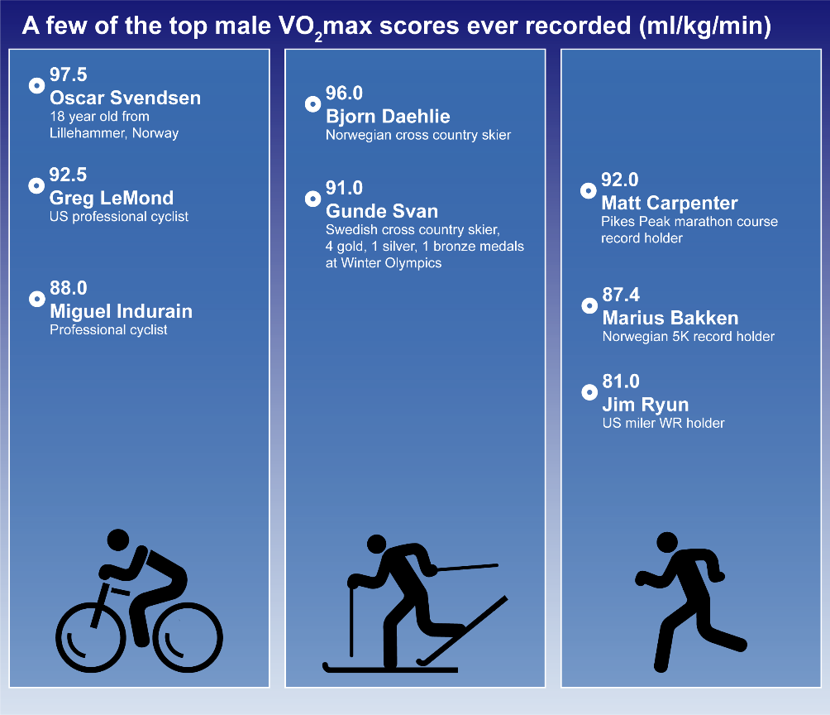
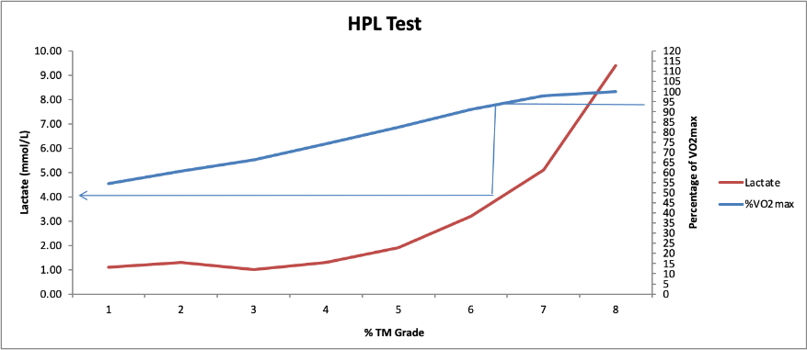
VO2max
Test results from UofSCSOMG VO2max lab
https://www.topendsports.com/testing/records/vo2max.htm
Notes:
VO2max
VO2max comparisons across human athletes and modes of exercise
Testing for VO2max and Lactate Threshold
VO2max is the measure that provides the maximal aerobic capacity potential in an athlete.
Lactate threshold is the percentage of an athlete's maximal aerobic capacity that the athlete can tap into and sustain during an endurance performance.
Lactate threshold is more trainable than VO2max in athletes with already high VO2max values

Slide 30
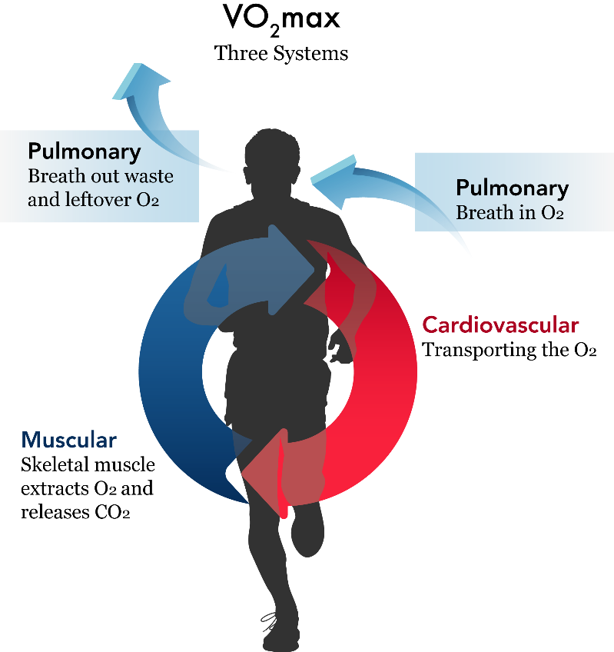
VO₂max depends on:
3 systems: Pulmonary, Cardiovascular, Muscular
Pulmonary: Inhalation, Exhalation, Respiration, Function
Cardiovascular: Cardiac output: stoke volume, heart rate, peripheral resistance; Muscle blood flow: capillary density, hemoglobin content
Muscular: Muscle mass, Muscle fiber type, Oxygen extraction: Muscle mitochondrial density, Oxidative enzymes
Notes:
VO2 max depends on:
Depends on pulmonary system, (body's ability to inhale/exhale respiratory function).
Clinical perspective: i.e., COPD patients would be significantly low health of all three systems.

Slide 31
VO₂max is affected by:
Heredity
Age
Sex
Body size and composition
Training status
Types of muscle fibers used during the exercise
Altitude
Temperature

Slide 32
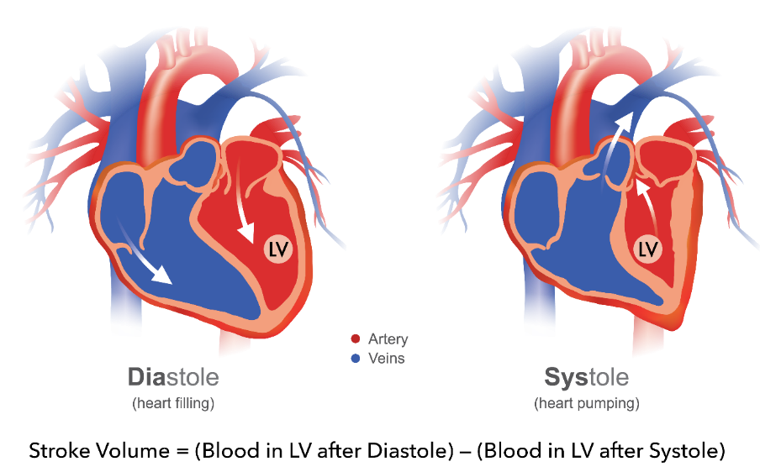
Cardiac Output (Q)
Q (L/min) = HR (beats/min) x SV (ml/beat)
Measures how much blood pumped by the heart per minute
Heart Rate = beats / min
Stroke vol. = End-diastolic vol. – End-systolic vol.
SV = EDV – ESV (units: ml / beat)
VO₂max = Q x (a-v)O₂diff
“Fick Principle”
Notes:
Cardiac Output (Q)
Q is the central component of VO2
Cardiac output = heart rate (beats per minute) x stroke volume (milliliters per beat).
How much blood is pumped by the heart per minute.
Stroke volume = end diastolic volume - end systolic volume.
HR = beats/min
Can change based on exercise training (exercise induced cardiac remodeling).
Left ventricle gets larger and the cardiac tissue around it slightly hypertrophies and improves stretch during diastole to increase filling
Physiological hypertrophy increases contraction ability during systole, increasing volume of blood out during cardiac muscle contraction,
This overall increases SV

Slide 33
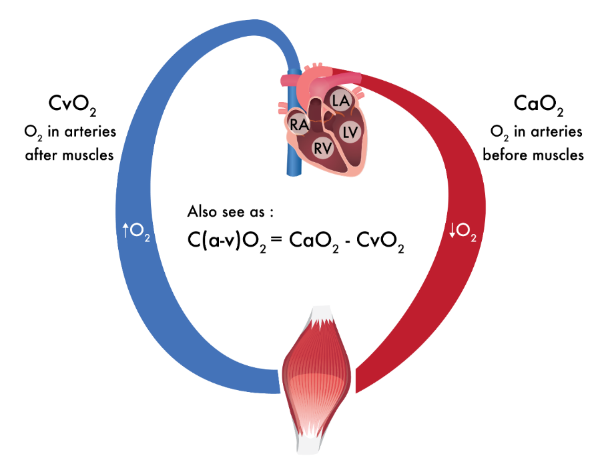
Arteriovenous Oxygen Difference: (a-v)O₂diff
Measures how much oxygen working muscles consume (mL/dL)
Also seen as: C(a-v)O₂ = CaO₂ – CvO₂
VO₂max = Q x (a-v)O₂diff
“Fick Principle”
Notes:
Arteriovenous Oxygen Difference: (a-v)O2diff
(a-v)O2diff is the peripheral component: how much oxygen is the skeletal working muscle consuming.
Poor muscle quality and quantity will not allow for extraction of enough blood oxygen to perform activity.
Alternatively, trained/conditioned skeletal muscle adapts to taking in more oxygen to beta-oxidize lipids and perform aerobic glycolysis for ATP production

Slide 34
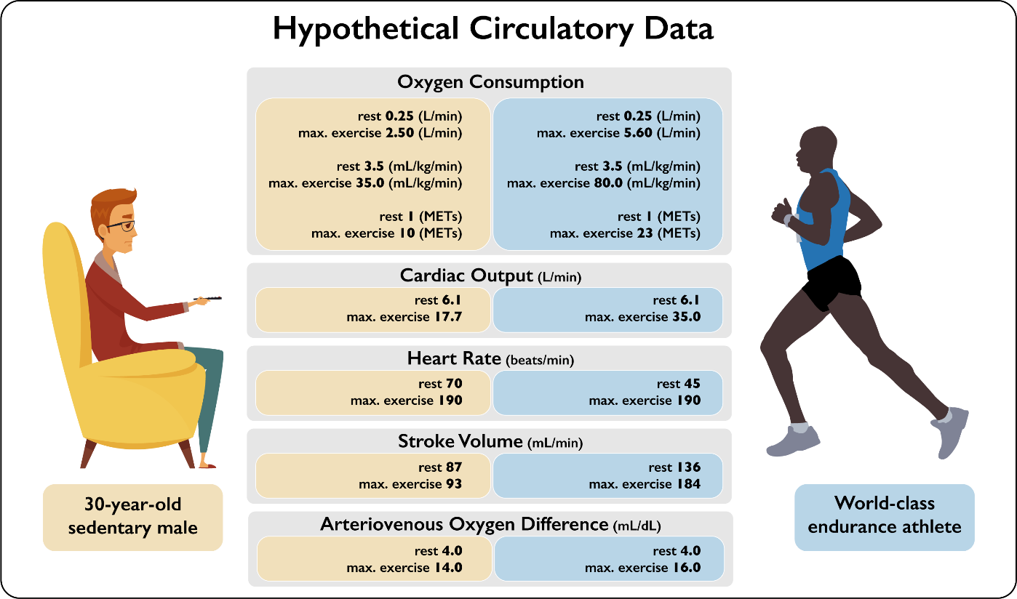
Fick Principle Comparisons
https://www.amazon.com/Exercise-Sport-Science-William-Garrett/dp/0683034219/ref=sr_1_1?dchild=1&keywords=9780683034219&linkCode=qs&qid=1611865362&s=books&sr=1-1
Notes:
Fick Principle Comparisons
Comparisons between an individual who's sedentary and a world class athlete during rest and at maximal exercise.
Resting values different in HR and SV, but not (a-v)O2diff
Maximal values different in SV and (a-v)O2diff, but not HR.
Why? Have Discussion……

Slide 35
We will get into this in Structure and Function!
Notes:
Go through the equation and how Q and (a-v)o2 diff is derived.

Slide 36
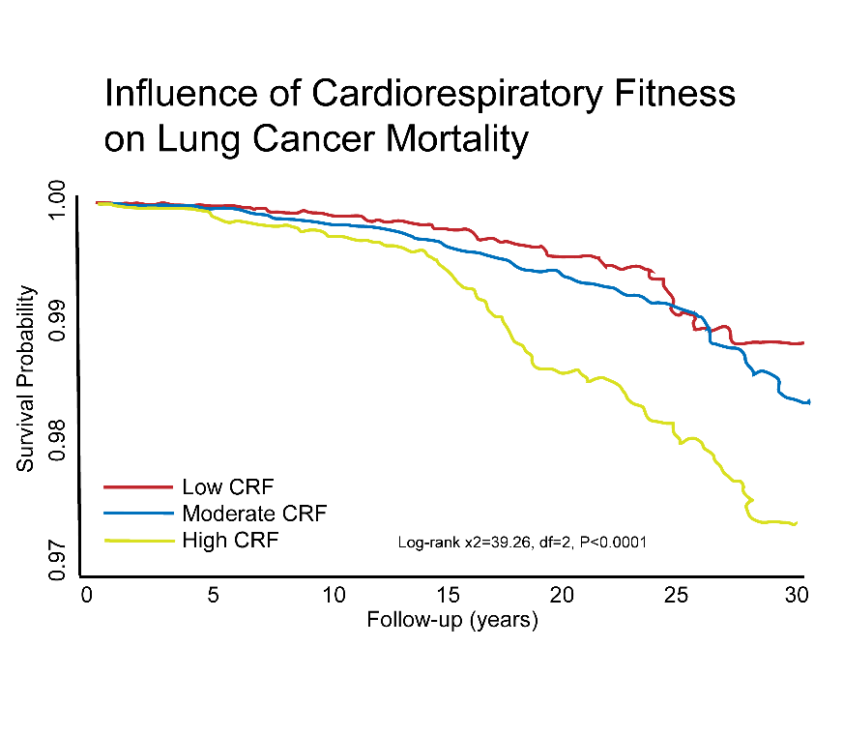
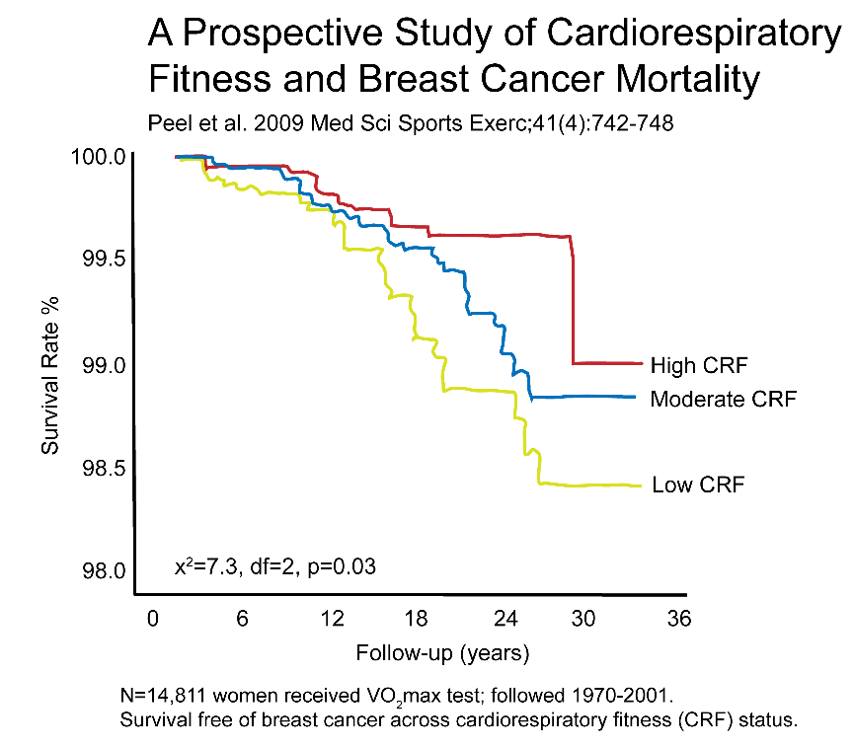
Cardiorespiratory Fitness and Health
Sui, Xuemei et al. MSSE. vol. 42,5 (2010): 872-8.
N=38,000 men received VO2max test; followed 1972-2003. ACLS, Dallas, Texas.
Link to Study
Link to Study
Notes:
Cardiorespiratory Fitness and Health
Maximal Cardiorespiratory fitness is inversely associated to chronic disease, including breast and lung cancer mortality.

Slide 37
Recap on Exercise Definitions, Testing, and Prescription:
What is the different Definitions of Movement?
List 3 TYPES of exercises that can be done for a cardiovascular workout.
List 3 TYPES of exercises that can be done for a strength workout.
Give an example of how you can manipulate the FREQUENCY at which you work out.
Give an example of how you can manipulate the INTENSITY of your workout.
Give an example of how you can manipulate the TIME for the exercise you do.
Give an example of how you can manipulate the TYPE of exercise you do.
Notes:
Recap on Exercise Definitions, Testing, and Prescription:
Review in class

Slide 38
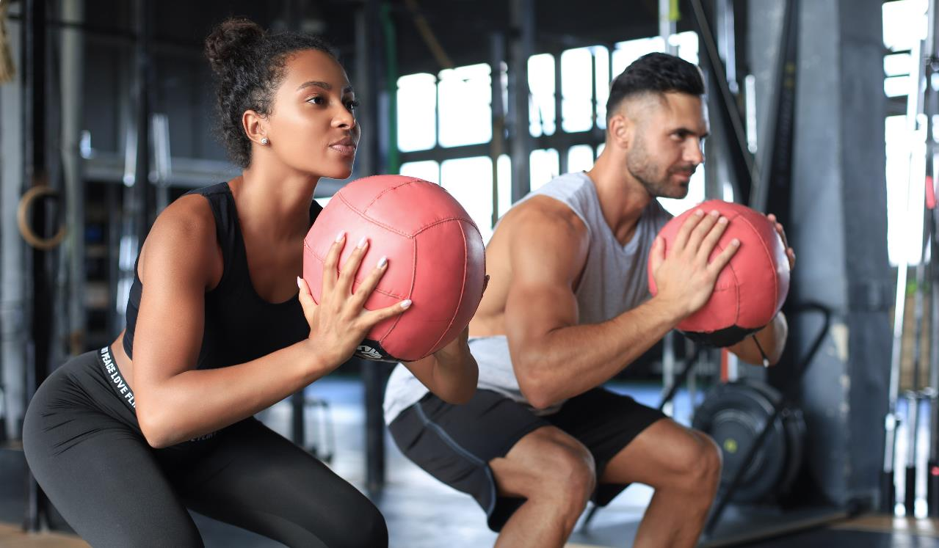
Break

Slide 39
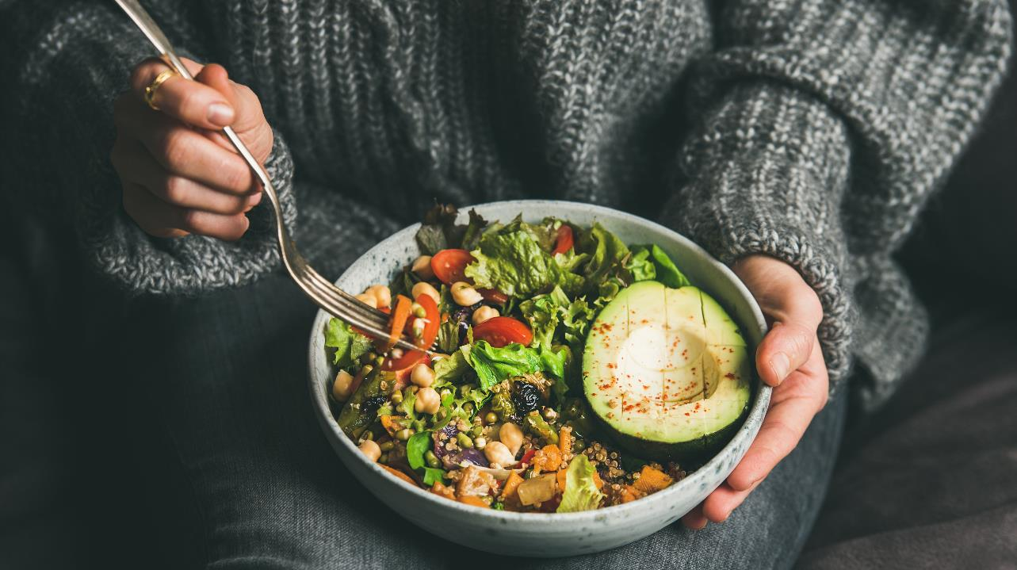
Nutrition
Notes:
Nutrition:
Biochemical Nutrition is extremely important to understand for mechanisms and Step 1 learning.
Applied Nutrition and what to discuss with patients is important for optimal patient care.
Patients will ask: What should I eat? What is healthy? Patient states, “I eat healthy.” You ask, “What do you eat?” Patient, “fried chicken.”
Understanding what we eat and if it's healthy or if it's marketed as healthy to us or marketed as healthy to your patients is something that you're going to need to delineate with your patients as well.
Important to respectfully address from a cultural perspective, SES perspective.
Meet the patient where they are at the beginning and work together over time to improve patient nutrition.

Slide 40
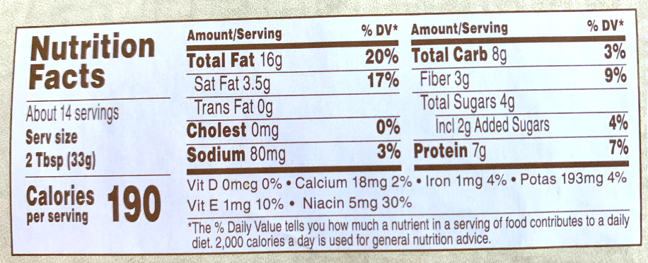
Macronutrients
Carbohydrates
4kcal/g
Fats
9kcal/g
Proteins
4kcal/g
50-60%CHO/15-25%PRO/10-30% TOTAL FAT (<10% SatFat)
If eating 2500 kcal/day, and receiving 20% protein, how many kcal of protein? How many grams of protein?
500 kcal
125 g
Flip this for Peanut Butter…what %protein and %fat?
Notes:
Macronutrients
Educate patients starting with basic macronutrients.
How many kcal per gram of each macronutrient.
The typical, most widely accepted and most widely utilized macronutrients change composition is somewhere around 50 to 60% carbohydrate in the diet.
So if a patient is eating 2500 kilocalories per day (recreationally-active college-aged person).:
50 to 60% of those should be carbs,
15 to 25% protein
No more than 30% total fat in that macronutrients with less than 10% of saturated fats.
The Standard American Diet (i.e., SAD) is typically high in saturated fat, about 20 to 30% of saturated fats.
Some T2D had up to 50% of total fats in their diet, very little protein on the rest being processed carbohydrates and/or simple sugars.
In class exercise: Calculate how many grams of protein is in a meal that contains 20% protein (2500 x 0.20 = 500 kcal x 4 g/kcal = 125 grams.
When this is broken down for patients through reading and calculating food lables, it brings eating certain food patterns into awareness and is one of the first steps for behavior change.
In class exercise: Calculate percentage of the following in a serving (2 Tbsp) of peanut butter.
Protein: 7g x 4g/kcal = 28 kcal……… 28kcal/190kcal = 14.7% protein
Fat: 16g x 9g/kcal = 144 kcal……. 144kcal/190kcal = 75.8% protein
Take home: while some patients may count peanut butter as a protein source, it is much more a fat source, and WILL cause weight gain if consumed in excess.
Data from NEJM research study demonstrates that persons who are overweight underestimate their caloric consumption by 47%: https://www.nejm.org/doi/full/10.1056/nejm199212313272701

Slide 41
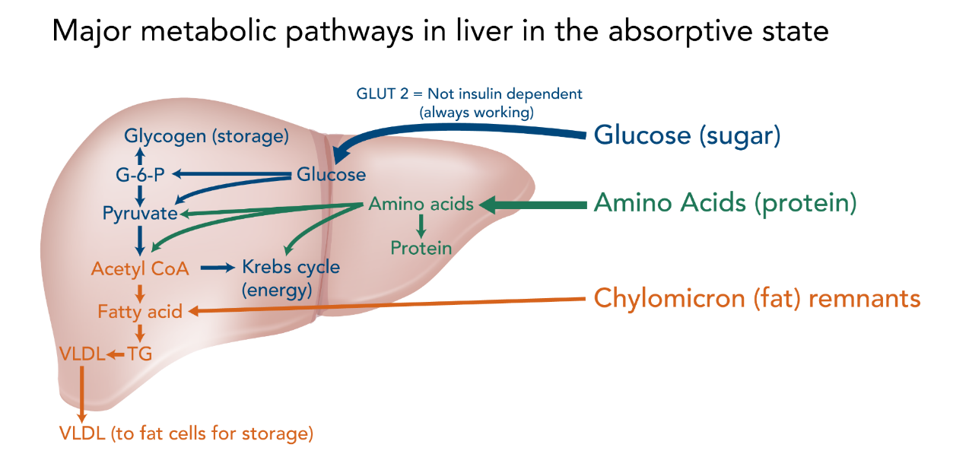
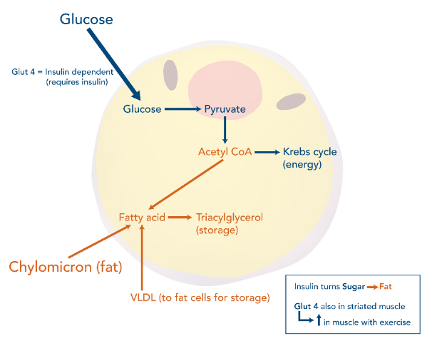
What Should I Eat? (And what should I tell my patients?)
“Eat (Real) Food, Not Too Much,
Mostly Plants”--Michael Pollan
Let’s think of macronutrients for a minute…….
Notes:
What Should I Eat? (And what should I tell my patients?)
Nutrition is traditionally taught in medical education from a biochemistry standpoint.
i.e. How macronutrients are processed and metabolized
Applied nutrition is like Michael Pollan’s quote: Eat real food. Not too much, mostly plants.
So what is meant by that statement? Some things we think are food are actually “food-like-substance
Real Food = Potato
Food-Like-Subtance = French Fries
Clinically want to pay attention to when we talk about eating calories, real food, not processed. Not too much, mostly plants.
Source
Lippincott’s Illustrated Reviews: Biochemistr, Sixth Edition (2014) UNIT V: Integration of Metabolism Chapter 24. The Feed–Fast Cycle

Slide 42
7 Rules for Eating—Michael Pollan (Easy for Patients, and Us, to Understand)
FED UP Documentary
Don't eat anything your great grandmother wouldn't recognize as food. "When you pick up that box of portable yogurt tubes, or eat something with 15 ingredients you can't pronounce, ask yourself, "What are those things doing there?" Don’t eat anything with more than five ingredients, or ingredients you can't pronounce.
Stay out of the middle of the supermarket; shop on the perimeter of the store. Real food tends to be on the outer edge of the store near the loading docks, where it can be replaced with fresh foods when it goes bad.
Don't eat anything that won't eventually rot. "There are exceptions -- honey -- but as a rule, things like Twinkies that never go bad aren't food.”
It is not just what you eat but how you eat. "Always leave the table a little hungry. Many cultures have rules that you stop eating before you are full. In Japan, they say eat until you are four-fifths full. German culture they say, 'Tie off the sack before it's full.’”
Families traditionally ate together, around a table and not a TV, at regular mealtimes. It's a good tradition. Enjoy meals with the people you love.
Don't buy food where you buy your gasoline. In the U.S., 20% of food is eaten in the car.
https://www.webmd.com/food-recipes/news/20090323/7-rules-for-eating#
Notes:
7 Rules for Eating—Michael Pollan (Easy for Patients, and Us, to Understand)
Take home: make it easy to understand!

Slide 43
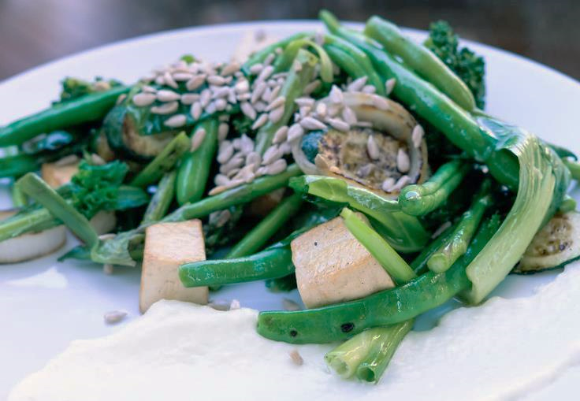
7 Rules for Eating—Michael Pollan (Easy for Patients, and Us, to Understand)
Whole Food, Plant-Based Diet
Whole Grains
Legumes
Vegetables and Fruits
Fats, Cholesterols, Protein
Calcium and Milk
Notes:
7 Rules for Eating—Michael Pollan (Easy for Patients, and Us, to Understand)
New Terminology: Whole Food, Plant-Based WFPB).
Human body was made to be the hunter gatherers or made primarily to eat plants with protein coming from animal sources being very minimal.
The SAD plate shows mostly anima-based protein, starchy carbohydrates (pasta, rice, potato), and very little plant-based foods like green-leafy, cruciferous vegetables, legumes, nuts and seeds.

Slide 44
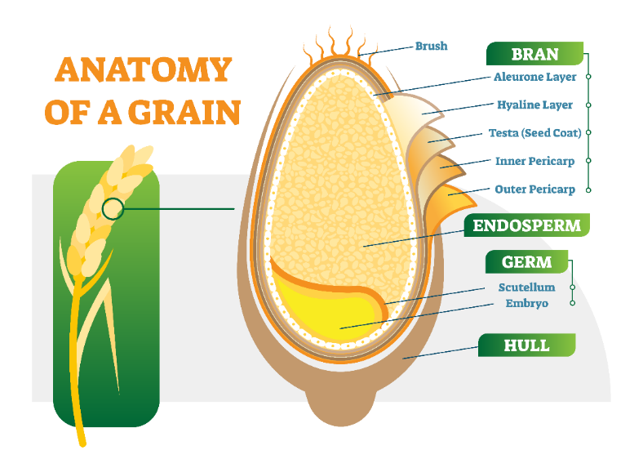
Whole Grains
These components have various effects on our bodies:
Bran and fiber slow the breakdown of starch into glucose—
maintaining a steady blood sugar rather than causing sharp spikes.
Germ: nutrient-packed with B vitamins, vitamin E, phytochemicals, and healthy fats
Phytochemicals and essential minerals such as magnesium, selenium and copper found in whole grains may protect against some cancers.
Fiber helps lower cholesterol (soluble) as well as move waste through the digestive tract (insoluble).
Fiber may also help prevent the formation of small blood clots that can trigger heart attacks or strokes.
Notes:
Whole Grains
Much more nutrient dense compared to processed grains that have lost the hull, the bran, and germ.
Germ is nutrient packed in vitamin B, phytochemicals, healthy fats, and most certainly fiber.
Less than 2% of the US population gets adequate fiber in their diet.

Slide 45
Veg and Fruit
Lowers blood pressure, risk of heart disease and stroke, some types of cancer.
Eat a variety of types and colors of produce in order to give your body the mix of nutrients it needs.
Try dark leafy greens; brightly colored red, yellow and orange vegetables and fruits; and cooked tomatoes.
Compared with those in the lowest category of fruit and vegetable intake (less than 1.5 servings a day), those who averaged 8 or more servings a day were 30% less likely to have had a heart attack or stroke. (1)
Notes:
Veg and Fruit
U.S. population (adult and youth) does not get enough vegetables in the diet (recommended 2-3 cups of veg and 1.5 to 2 cups per day). CDC data indicate only 1 in 10 people consume the recommended amount of veg. https://www.cdc.gov/media/releases/2017/p1116-fruit-vegetable-consumption.html#:~:text=Depending%20on%20their%20age%20and,of%20a%20healthy%20eating%20pattern
Evidence that intake of veg and fruit is associated with lower blood pressures, reduction in heart disease and stroke risk, and lower colon cancer.
Fruit and vegetables who averaged eight or more servings a day were 30% less likely to have a heart attack or stroke

Slide 46
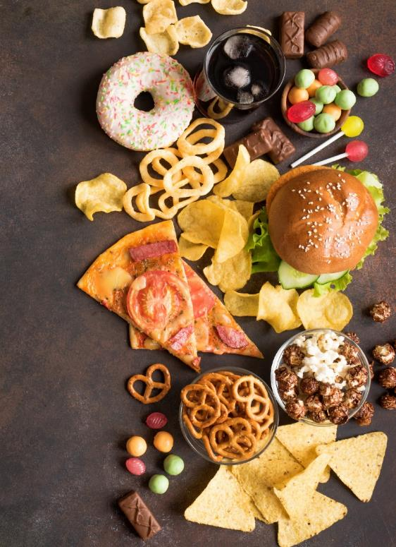
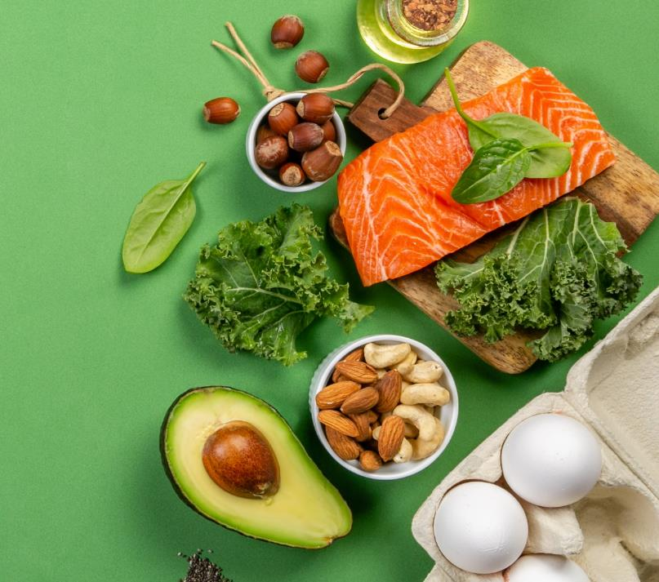
Fats and Cholesterol
Notes:
Fats and Cholesterol
Fats are not “bad.”
In the 80’s/90’s, the big fat in marketing was all about “low-fat diet.” Everything you saw with marketing was low fat; but it was replaced with sugars, high fructose corn syrup, etc. And then sugar was bad, so they started “sugar substitutes.”
Fat is essential for thermoregulation, hormone production and balance, protection of internal organs, etc.
Consuming TOO MUCH fat, or too much saturated fats, become unhealthy and manifest in higher oxidative stress in the body.
There are “Good” fats, “Bad” fats, and “Ugly” fats.

Slide 47
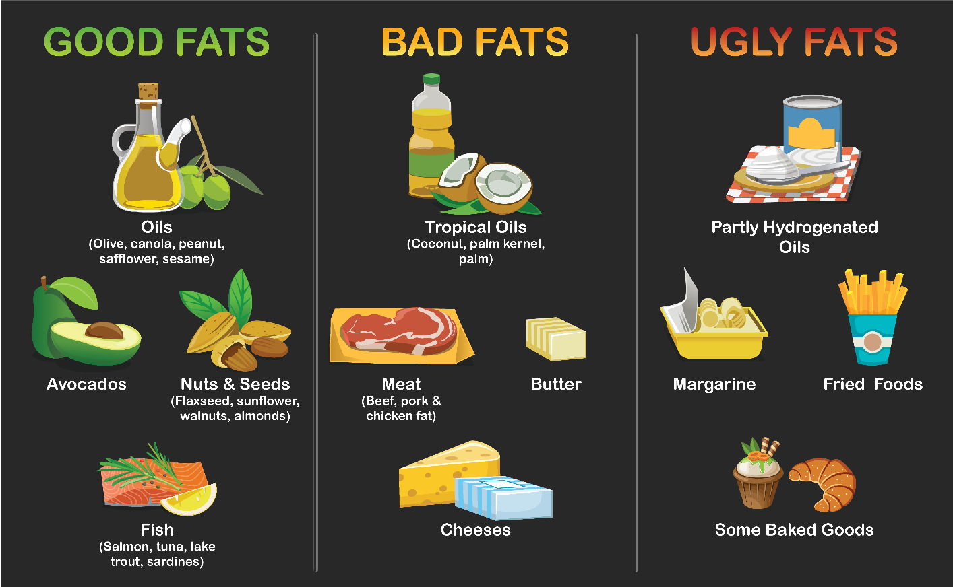
Fats and Cholesterol
https://www.heart.org/en/healthy-living/healthy-eating/eat-smart/fats/the-facts-on-fats
Notes:
“Good” fats vs, “Bad” fats.
Rather than adopting a low-fat diet, it’s more important to focus on eating beneficial “good” fats and avoiding harmful “bad” fats. Fat is an important part of a healthy diet. Choose foods with “good” unsaturated fats, limit foods high in saturated fat, and avoid “bad” trans fat.
Why?
“Good” fats have more concentration of mono and poly unsaturated fats, omega-3 fatty acids, and are anti-inflammatory, examples such as salmon, olive oil, flaxseed oil, avocados.They are not processed and natural.
Example: Extra virgin olive oil is the cold pressed, non processed, literally cold, pressed from the fruit itself; while light olive oil is all chemically processed and is like the third or fourth of what else can we do with this fruit to get something out of it. Therefore, being educated on the difference is important.
“Bad” fats have more saturated fats, many times includes cholesterol, and can be found in examples such as red meat, cheese, butter, coconut oil….
“Trans” fats….added to this slide, perhaps?
When trans fats were allowed on the market, processes such as partially hydrogenating chemical structures to items such as he margarine or the peanut butters solid at room temperature was used. Demonstrated to increase risk of cardiovascular disease, so taken off the market in 2018. Food and Drug Administration mandated that food labels demonstrate that a food item have zero trans fats, but in reality it can have up to 0.5 grams of trans fats without reporting it.
Trans fats can still be found in the cooking and baking process for cookies, doughnuts, etc.

Slide 48
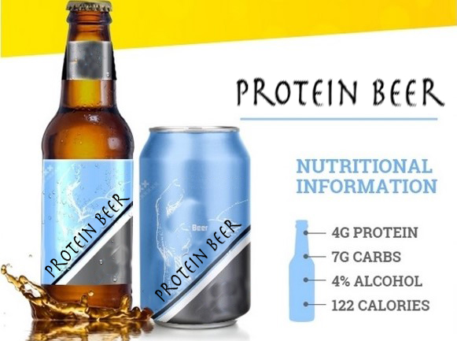
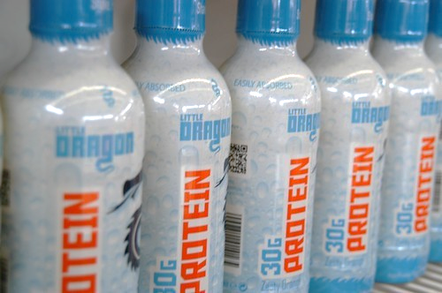
Protein
0.8 – 1.2 grams of protein for every kilogram of body weight per day
8 grams of protein for every 20 pounds of body weight.
wide range for acceptable protein intake—anywhere from 10 to 35 percent of calories each day depending on activities.
RDA: 46 grams/day for women and 56 grams/day for men.
Too much? Weight gain, constipation, kidney damage, cancer, heart disease (primarily from animal sources—Why?)
Notes:
Protein
The majority of Americans are not protein-deficient.
Very high marketing strategies to “increase protein in our diet.”
Protein shakes, protein beer, protein water = all examples of marketing gimmicks.
Average individual should target 0.8 to 1.2 g of protein per kilogram of body weight daily.
Example Calculation: if a person weighs 56 kg, then an average of 56 grams of protein is a good target.
Consequences of too much protein? Weight gain (converted to fat), constipation (if animal based), kidney damage, etc,

Slide 49
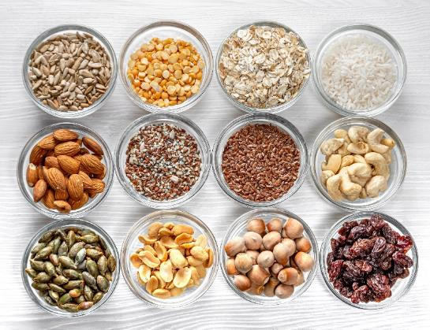
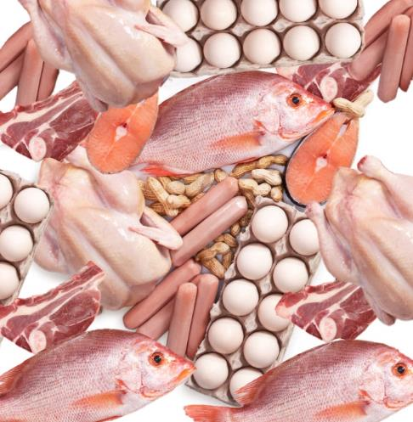
Protein
All Protein Isn’t Alike
What comes along with the protein?
Healthy vs. harmful fats; beneficial fiber or hidden salt
6-ounces of wild salmon
34 grams of protein; low in sodium, excellent sources of omega-3 fats, a type of fat that’s especially good for the heart.
Cup of cooked lentils
18 grams of protein,15 grams of fiber, no saturated fat or sodium.
Health Professionals Follow-Up Study and Nurses’ Health Study
For every additional 3-ounce serving of unprocessed red meat consumed, risk of dying from CVD increased by 13%.
For every additional 1.5 ounce serving of processed red meat consumed each day—equivalent to one hot dog or two strips of bacon—was linked to a 20% increase in the risk of CVD death.
Dr Mercola articles
Notes:
Protein is not Alike:
Animal based protein comes with fats and cholesterol, which can be inflammatory.
Plant based protein comes with fiber and little to no fat.

Slide 50
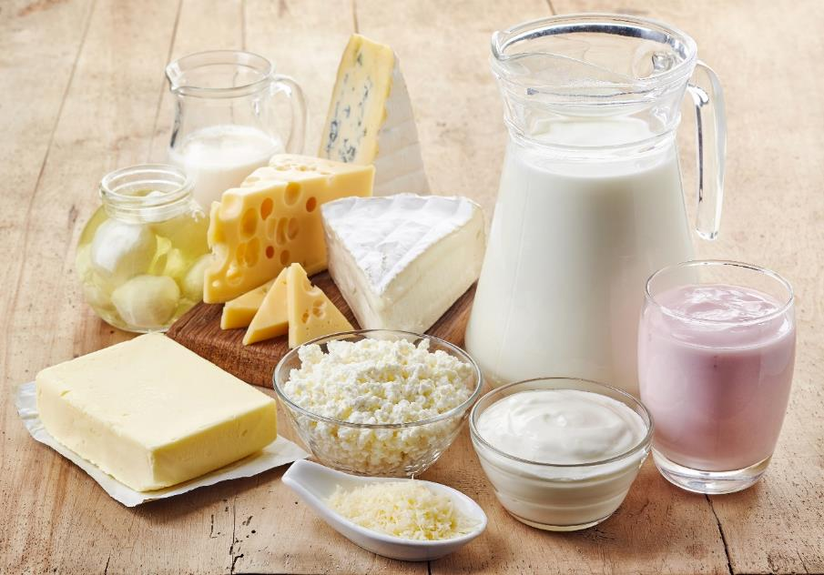
Dairy Products
It’s the Calcium that is important.
But milk isn’t the only, or even best, source.
While calcium and dairy can lower the risk of osteoporosis and colon cancer, high intake can increase the risk of prostate cancer and possibly ovarian cancer.
Dairy products can be high in saturated fat
Non-dairy sources of calcium include collards, bok choy, fortified soy milk, & baked beans.
Notes:
Dairy Products
Calcium can come from a whole host of sources, primarily leafy green vegetables, potatoes, soy and almond milk.
Dairy contains hormones, growth factors, and more casein protein than is needed for an adult human.
May increase cancer risk.

Slide 51
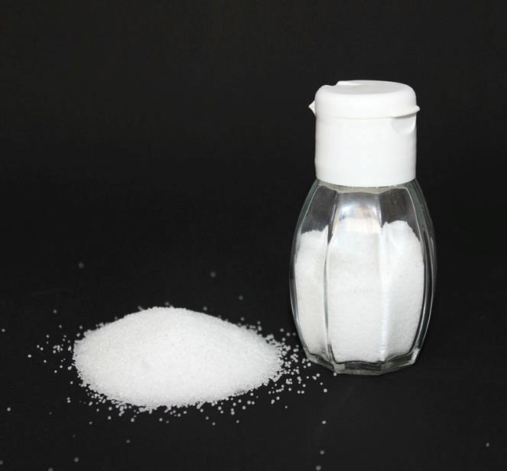
Salt (Sodium)
Too much sodium in the diet can lead to high blood pressure, heart disease, and stroke.
RDA: 2,300 milligrams (one teaspoon).
Most Americans consume at least 1.5 teaspoons per day, far more sodium than our bodies need.
American Heart Association recommends that at-risk individuals should limit daily sodium intake to 1,500 milligrams (2/3 of a teaspoon)
People over age 50
People who have high or slightly elevated blood pressure
People who have diabetes
African Americans
Notes:
Salt (Sodium)
RDA = no more than 2300 mg a day.
Americans consume at least 1.5 times the RDA
Far less comes from table salt than from processed foods (deli meats, breads, soups, canned veg). It is “hidden.”
Hypertension patients should consume no more than 1500 mg a day.
Clinical Pearl: ask patient to provide a 3-day diet history (2 weekdays and 1 weekend day) to see where sodium sneaks up.

Slide 52
Water
Excellent calorie-free, sugar-free choice.
IOM: 125 ounces (about 15 cups) for men and 91 ounces (about 11 cups) for women. (1)
“Spruce up” water:
Sliced citrus fruits or zest (lemon, lime, orange, grapefruit)
Crushed fresh mint
Peeled, sliced fresh ginger or sliced cucumber
Crushed berries
Sparkling water with an ounce (splash) of juice
Notes:
Water
Dehydration is linked to negative health outcomes: https://pubmed.ncbi.nlm.nih.gov/23121346/
Important to stay hydrated and drink enough water throughout the day.

Slide 53
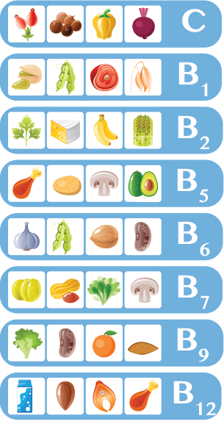
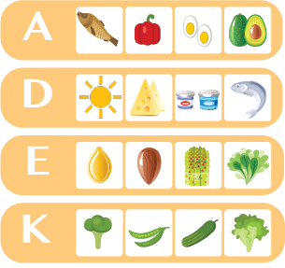
Vitamin classification
Water soluble
Fat soluble
VITAMINS
Notes:
Vitamin classification
Important to know which foods contain which vitamins (fat vs water soluble) and eat a variety of foods to obtain adequate vitamins in the diet.
Adequate vitamin intake (and no need for a supplement) if a high-quality, whole food plant based non processed food pattern is adopted.
Examples:
vitamin C: broccoli, Brussels sprouts, cauliflower, spinach, cabbage
vitamin B’s: dried milk, oats nuts,
Important to monitor Vitamin B12 if vegan, as a person can become deficient.
fat soluble vitamins, your A, D, E and K can come from a whole host of foods.

Slide 54
Now let’s talk nutritional goals and do some Lifestyle Medicine work

Slide 55
Dietary Recall
Advantages
easily obtained
patients can usually recall
Good for patients with diabetes
Disadvantages
difficulty estimating portion sizes
difficulty remembering everything
24 hours may not be representative of diet
pressure to say what is perceived as desired
Notes:
Dietary Recall
At least a 24-hour recall on yourselves on all the foods that you've got, and I want you to look at minimum of a day.
More accuracy with a tracking app for 3 days (two weekdays and one weekend day, as humans tend to eat differently on the weekends.

Slide 56
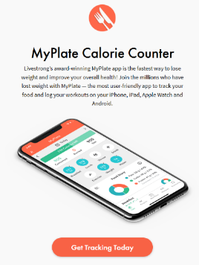
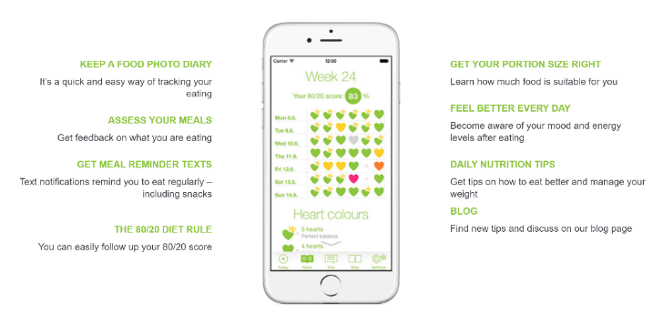
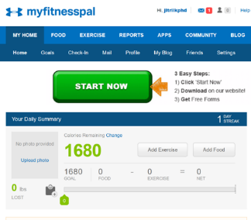
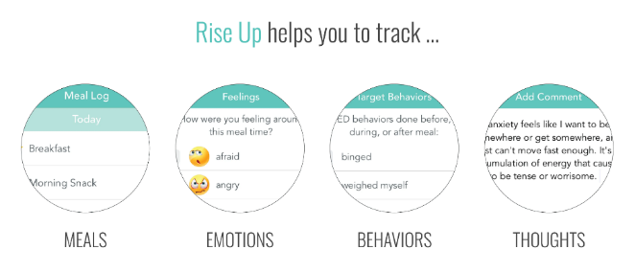
Lifestyle Diary Apps to Track What You Eat and How It Affects You
https://www.livestrong.com/myplate/
https://seehowyoueat.com/
https://youate.com/
https://www.myfitnesspal.com/
https://www.recoverywarriors.com/app/
Notes:
Lifestyle Diary Apps to Track What You Eat and How It Affects You
Explore different apps to use for tracking.
Here are some commercial examples.

Slide 57
Nutritional Goal Setting (move on….)
Challenges to your diet?
Plans?
Goals?
Notes:
Nutritional Goal Setting (move on….)
Exercise: What are your challenges to implementing a healthy diet?
What are your plans to initiate a health diet pattern?
What would your measurable goal be to demonstrate success?

Slide 58
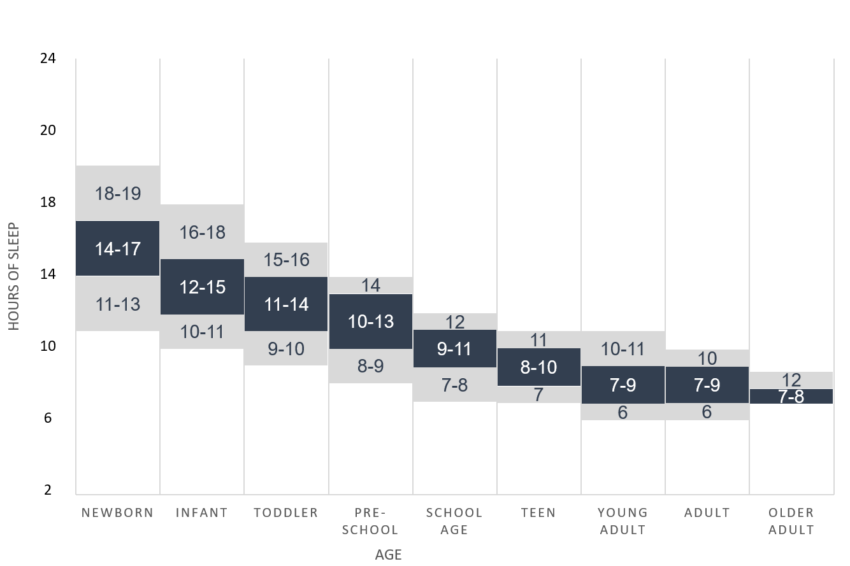
How Much Sleep Do You Need?
Sleepfoundation.org
National Sleep Foundation Sleep Duration Recommendations
Notes:
How Much Sleep Do You Need?
sleep is one of the six pillars of lifestyle medicine.
Incredibly important to average 7 to 9 hours of good quality sleep a night.
Reduce poor sleep quality through not having electronics in the bedroom, a cool room environment that is totally dark.

Slide 59
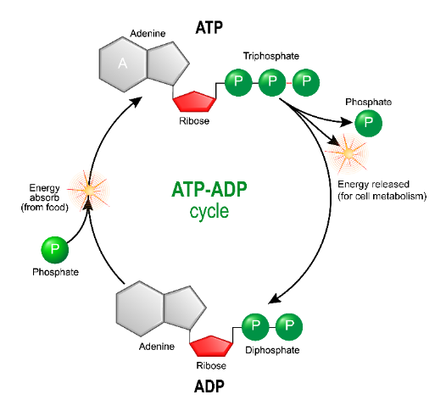
Sleep and Adenosine?
Where does it come from?
Adenosine levels are low just after sleeping
Adenosine levels build throughout the waking hours and are elevated if awake for long periods of time
Circadian rhythms of adenosine triphosphate contents in the suprachiasmatic nucleus, anterior hypothalamic area and caudate putamen of the rat — negative correlation with electrical activity - ScienceDirect
Notes:
Sleep and Adenosine?
ATP is broken down from not just physical activity but thinking!
Adenosine levels rise in the brain throughout the day; when asleep, levels decrease, and we are more energized in the mornings (with a good night sleep).
And as the day goes on, start getting that mental fog and that tiredness, can't concentrate as much. Adenosine is building up.

Slide 60
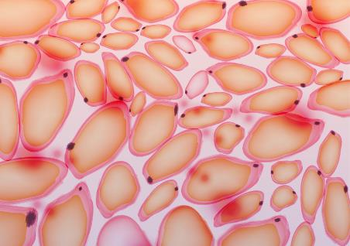
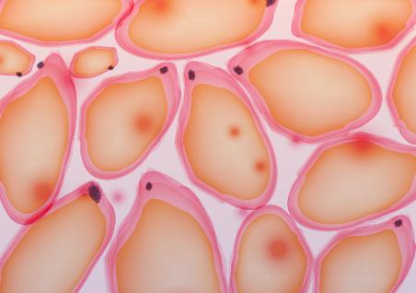
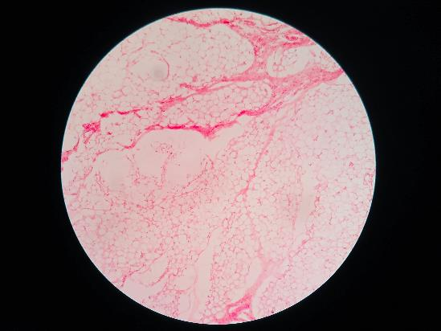
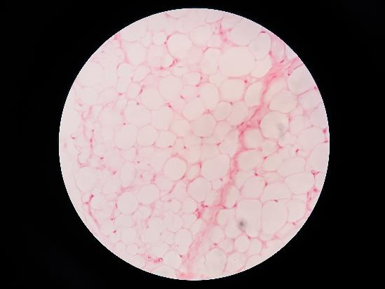
One Night’s Sleep Deprivation on Fat Cells
Adipocytes
Hypertrophied Adipocytes
Notes:
One Night’s Sleep Deprivation
Can cause inflammation across tissues
Can cause hypertrophy in the adipose tissue
Can cause a breakdown in skeletal muscle in in terms of metabolism.

Slide 61
One Night’s Sleep Deprivation Causes All This…
Structural Muscle Loss
One Night’s Sleep Deprivation
Can cause inflammation across tissues
Can cause hypertrophy in the adipose tissue
Can cause a breakdown in skeletal muscle in in terms of metabolism.
Notes:
One Night’s Sleep Deprivation
Can cause inflammation across tissues
Can cause hypertrophy in the adipose tissue
Can cause a breakdown in skeletal muscle in in terms of metabolism.

Slide 62
Chronic Poor Sleep Hygiene
Notes:
Chronic Poor Sleep Hygiene
Can be a contributing factor to Type 2 Diabetes development through these mechanisms.
Sources:
https://www.diabetichealthclinic.org/wp-content/uploads/2014/04/Cleveland.pdf
https://www.nature.com/articles/nutd201719

Slide 63
Controlling Your Health
Notes:
Controlling Your Health
Utilize the 6 pillars of Lifestyle Medicine to help maintain our own health.

Slide 64
Review your Lifestyle Medicine Goals
Open your goals and review what you wrote.
Write in the same document (today’s date) and how you are doing with your goals.
Write what can you do to maintain, improve your goals?
New question for open discussion: how can your challenges to maintain or improve your goals be translated to your patients’ care?
Notes:
Review your Lifestyle Medicine Goals
In class exercise…..

Slide 65
LM Learning Objective #3: Demonstrate a personal commitment to healthy lifestyle choices
Evaluate your current lifestyle habits (e.g. eating too much sugary foods, not getting enough sleep or exercise)
Write 1-2 sentences to summarize your current habits
Choose ONE lifestyle behavior you want to change or maintain this year
Exercise/PA, nutrition, sleep, emotional wellness, stress resiliency, smoking cessation, avoiding risky substance use, emphasis on behavior
Set your Goal with measurable outcomes
What is a “Goal?”
Include directions, similar to those you might give a patient, for achieving the goals. Describe the method you will use to measure your outcomes.
Notes:
Instructor to go through goal setting with students....ccc.

Slide 66
LM Learning Objective #3: Demonstrate a personal commitment to healthy lifestyle choices
Set your goal with measurable outcomes
Examples: (These are brief examples. Your description should be more detailed and include the process you will use to meet the goal.)
Goal Diet/Nutrition: Increase fruit and vegetable consumption to 5 servings a day Plan: Include a plan of what fruits and vegetables you will purchase and when you will eat them Data: Keep a log of daily fruit and vegetable intake.
Goal Physical Activity: Engage in 30 minutes of moderate physical activity each day. Plan: Include a plan for the type of activity you will do and when you will do it. Data: Keep a log of daily physical activity.

Slide 67
“Eat (real) food, not too much, mostly plants”
Michael Pollan

Slide 68
Thank You

Slide 69
Image Documentation
Double click to view image documentation

