Slide 1
Lifestyle Medicine and Reproductive Health
Notes:
Introduction
•Today’s topic will cover the effects of lifestyle on reproductive health, as well as the role Lifestyle Medicine plays in Reproductive Health.
•This session covers the female from pre-conception through gestation, as well as post-partum, then provides an brief of the child.
•This session also briefly touches on the effects of lifestyle on reproductive health for the male.

Slide 2
DEVELOPED BY
JENNIFER L. TRILK, PhD, FACSM, DipACLM
ADAM TYSON, MD
Associate Professor, Dept. of Biomedical Sciences
University of South Carolina School of Medicine Greenville
Obstetric Hospitalist
Prisma Health
Notes:
Developers and Presenters
This session was developed and originally delivered by:
•Jennifer Trilk, PhD, FACSM, DipACLM, from the University of South Carolina School of Medicine Greenville
And
•Adam Tyson, MD, from Prisma Health’s Department of OBGYN

Slide 3
OBJECTIVES
Describe the effects of obesity on male and female fertility.
1
Explain the obesity, polycystic ovarian syndrome (PCOS)/infertility link in women.
2
Explain the mechanisms in which exercise and nutrition affect risk of gestational diabetes mellitus, hypertension and preeclampsia.
3
Cite the current nutritional recommendations for adult women during preconception, pregnancy, and lactation; identify at least four types of foods or supplements that should be included or avoided in the diet during this period.
4
Understand the effects of exercise on maternal gestational low back pain, diastasis, and musculoskeletal laxity. List the absolute and relative contraindications to exercise during pregnancy.
5
Notes:
The Objectives of this session are listed, and will cover:
•Describe the effects of obesity on male and female infertility.
•Explain the obesity, PCOS, infertility link
•Explain mechanisms by which exercise and nutrition effect risk of certain obstetrics conditions
•Cite the nutritional and exercise recommendations as well as what should be avoided during pregnan
•Understand the changes in maternal physiology during pregnancy, how these changes affect the individual’s ability to perform certain activities, and the contraindications to exercise during pregnancy.

Slide 4
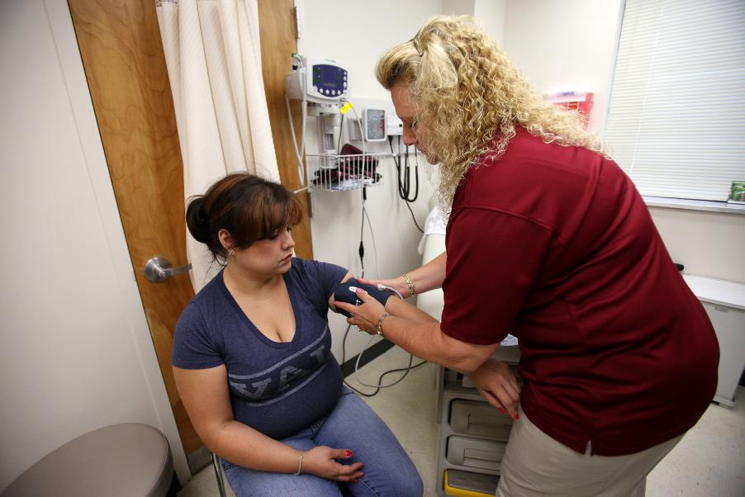
The Larger Picture
Patient Visit
Reproductive health visits are a preview to understanding patient health risks later in life.
Visits can be a gateway into health care and an incentive to motivate change in a patient.
Notes:
THE LARGER PICTURE
•The period of pregnancy is a short period in a woman's life.
•Benefit is that it brings a lot of women into health care that don't come for health care a lot.
•For reasons of otherwise being young and healthy, not having access and/or funding for health care.
•But during pregnancy, many women gain funding and/or access, and also gain motivation to have a healthy baby.
•Gives provider a chance to explore, discover diagnose conditions that would have gone undiagnosed otherwise.
•Pregnancy can be a preview of potential co-morbidity risks or diagnosed co-morbidities that might affect the female later in life.
•Risk of diabetes and heart disease later in life can be predicted somewhat by conditions that developed during pregnancy
•Opportunity for us to engage these women into discussion about long term health at a time when many women are more motivated to work on their health work on lifestyle changes.
•Many women stop smoking or drinking during pregnancy.
•Prime time to look for opportunities to engage people at a moment when they're ready for lifestyle changes that are small and build upon success.

Slide 5
Obesity And Reproductive Health
Obesity negatively affects ovulation and sperm motility, response to fertility treatment, pregnancy rates and outcome.
30% to 47% of overweight/obese women have irregular menses
~30–40% of infertility cases can be attributed to male infertility
The Practice Committee of American Society for Reproductive Medicine, 2008; Clark et al. 1998;
Notes:
OBESITY AND REPRODUCTIVE HEALTH
•Obesity is a real problem for reproductive health, including affecting fertility in men.
•The sperm are not as mobile as they should be. The morphology can often be abnormal in obese men and cause fertility to decline in ~30% of men.
• Obesity is a real problem for reproductive health, including affecting fertility in women.
•Overweight women often have irregular menstruation and they respond differently to treatments.
•Obese women have higher risks and in pregnancy.
•Obese women have a higher rate of neural tube defects in certain other fetal malformations (not intuitive, but a real effect).
•Irregular heavy bleeding occurs in up to half of overweight to obese women.

Slide 6
Male Obesity/Infertility
Effects of obesity on male fertility
PHYSICAL | SEMINAL | HORMONAL
hErectile dysfunction | Oligozoospermia | hEstrogen
hScrotal temperature | Azoospermia | iTestosterone
hSleep apnea (disrupts nocturnal rise in testosterone) | hDFI | hInsulin
 | iSemen volume | hLeptin
The effect of obesity on sperm disorders and male infertility | Nature Reviews Urology
Notes:
Mechanisms for reduced fertility in men:
•An increase in adipocytes in obese men increases the number of adipose in sites that effects hormonal regulation:
•Increased levels of estrogen in the male, decreased levels of testosterone, rising levels of insulin, all affects sperm function.
•Obesity decreases the function of male sexual function, and scrotal temperature rises, causing abnormal effects on the sperm in terms of impairing their mobility and also the morphology.
•Poor sleep due to sleep apnea affects the cyclic nature of the testosterone.

Slide 7
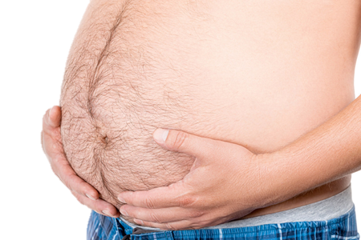
Male with Obesity/Infertility
Male 52.8 BMI (Obese)
Expert Rev Endocrinol Metab © 2010
Sperm concentration/total sperm count negatively associated with BMI >25 kg/m²
- reduced normal sperm morphology and motility less consistent across studies
Increased VAT associated with ↓ serum free and total-testosterone levels
↑ serum estrogens
Male with Obesity
BMI >30 kg/m²
High serum estradiol
Insulin resistance
High serum leptin
Hypogonadism
Subfertility
Notes:
Mechanisms for reduced fertility in men:
•As BMI rises, sperm testosterone levels decrease, sperm concentration decreases, and then the decreased testosterone levels are associated with visceral adipose tissue.
•A rise in serum estrogen, which is produced in the peripheral adipose tissue, also negatively affects the balance of testosterone in men.

Slide 8
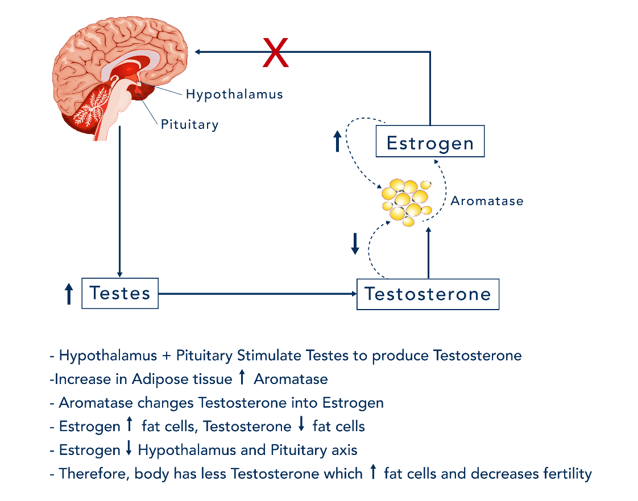
Hypogonadal-Obesity Cycle
Obesity Cycle
Medscape.com & Expert Rev Endocrinol Metab @2010 Expert Reviews Ltd
Adipose-derived aromatase converts androgens to estrogens
Adipose rich source of peripheral estrogens that regulate testicular function
In response to an increased adipose tissue mass, elevated E2 suppresses the HPT axis
Reduced T contributes to abdominal adipose tissue distribution.
Expert Rev Endocrinal Metalab 2010 Expert Review Ltd www.medscape.com
Notes:
Mechanisms for reduced fertility in men: More detail on conversion of (T and androstendione) to estrogens (17β-E 2 and estrone)
•Aromatase from peripheral adipose tissue drives the conversion of testosterone into estrogen in men.
•Testosterone reduces that increases fat deposition in the midsection, which produces more estrogen, which deposits more fat, which continues a vicious cycle.
Source: Expert Rev Endocrinol Metab @2010 Expert Reviews Ltd

Slide 9
Other Mechanisms
Testicular heat-stress-/hypoxia-induced apoptosis
Endocrine disruption by 'obesogens‘
environmental chemicals that may be stored in adipose tissue and have the potential to modulate both estrogenic and adipogenic pathways
http://www.Medscape.com/viewarticle/719489_6
Notes:
Other mechanisms for reduced fertility in men: Increased scrotal temperature and Obesogens
•The scrotum is positioned below the body for a purpose. This position regulates the temperature of the rapidly producing cells. If the temperature is too high, regulation of the cell function is impaired.
•Obesogen are chemicals specifically stored in adipose tissue. BPAs found in plastic bottles have estrogen-like compounds in them.
•Note: BPA exposure can be mapped to zip codes in areas where there's high levels of industrial waste. Endometriosis in Utah had higher incidences in certain zip codes, and those were associated with industrial sites that produced a lot of plastics.

Slide 10
Mechanisms: Obesity and Infertility in Women
VAT associated with insulin resistance
Subsequent increased functional androgen levels
caused by suppression of sex hormone–binding globulin synthesis and increased ovarian androgen production
Chronic elevation of circulating estrogen via aromatization from AT
hyperandrogenism, menstrual cycle abnormalities, clinically manifested anovulatory cycles and subfertility
Leptin inhibits ovarian follicular development and steroidogenesis
may contribute to reproduction difficulties in obese women
Obesity and female infertility: potential mediators of obesity's impact - ScienceDirect
Notes:
Mechanisms for reduced fertility in women:
•Visceral adipose tissue increases insulin resistance, a hallmark of the polycystic ovary syndrome (PCOS).
•Adipocytes increase circulating androgens in women:
•Increased production of androgens
•Disruption the production of sex hormone binding globulin that normally binds testosterone to take it out of circulation. Lower levels of SHBG cause for increased functioning testosterone.
•The women's menstrual cycle is all about pulse flow of the hormones and cyclic production of the hormones. Increased adiposity that constantly produces estrogen is not under regulation by the pituitary gland. Increased circulating estrogen blocks the ovulation triggers which throws off the normal cycle.
•Clinical effects: Abnormal bleeding due to reduced signaling to ovulate every month. Endometrium continues to grow and then it is believed women have normal leptin production.
•Adipose tissue also seems to affect development of follicles that has a direct effect on the gonad in terms of decreasing their fertility.

Slide 11
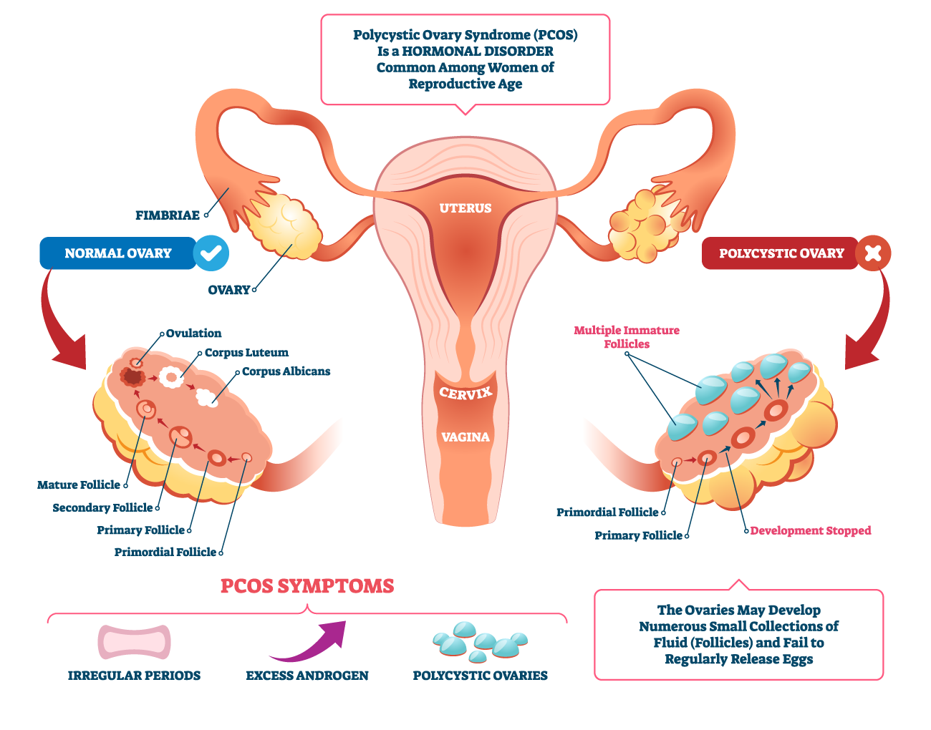
PCOS – Vicious cycle

Slide 12
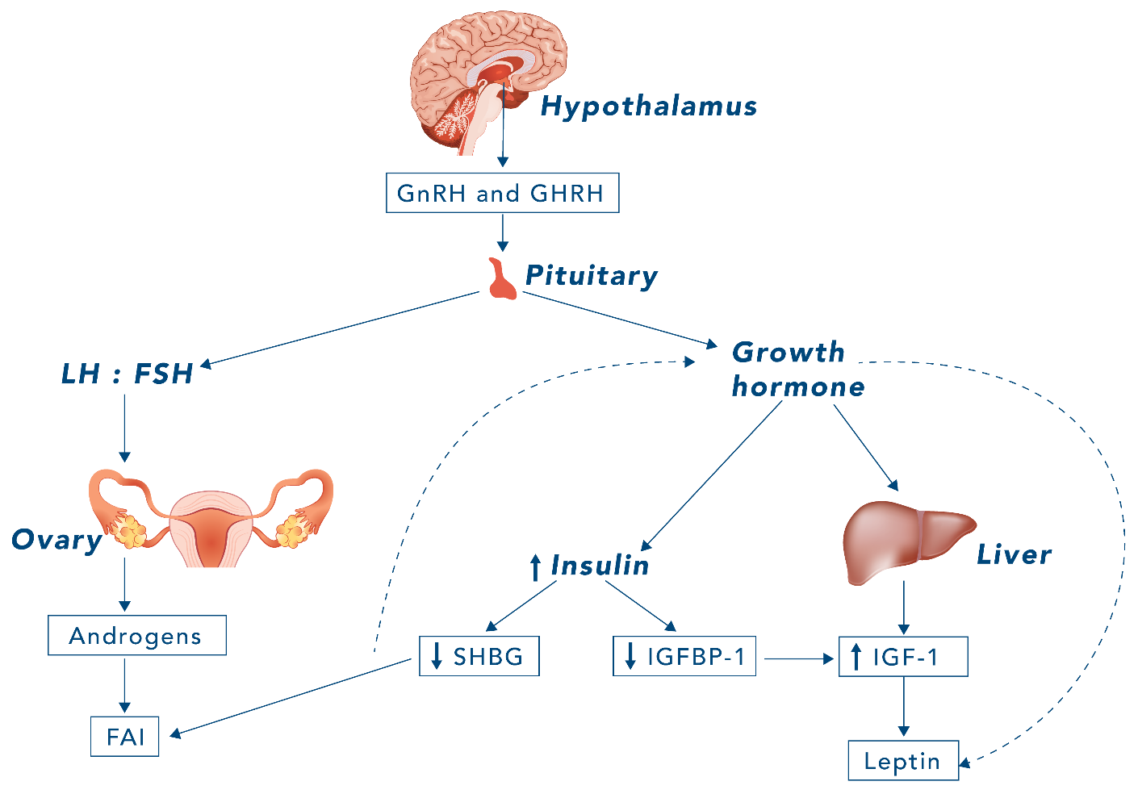
PCOS – Vicious cycle
Notes:
PCOS – Vicious cycle
Androgen levels: FAI = 100*([Total testosterone]/[SHBG])
High FAI: androgenic alopecia (balding); hirsutism; severe acne = PCOS
PCOS
•Increased GnRH pulse amplitude (but not frequency); incr LH:FSH; incr androgens
•Increased GHRH; incr GH; incr insulin; incr LH sensitivity (incr androgens); decr insulin sensitivity (post-receptor binding); decr SHBG; incr TSH (incr adipose-incr leptin-incr TRH)
More detail regarding PCOS:
•Hypothalamic pituitary axis or hypothalamic gonadal axis is what controls the cycle; dependent on GNRH and on the pulse style release of GNRH.
•LH and FSH ratios that normally stimulate the ovary (left diagram) and normal production and cycling of those hormones creates a very tightly controlled system.
•Increased androgens produce smptoms of abnormal bleeding, hirsutism, changes in skin color related to androgenism.
•Overproduction of growth hormone (right diagram), over production of insulin, insulin resistance, and downstream effects on hormonal function.

Slide 13
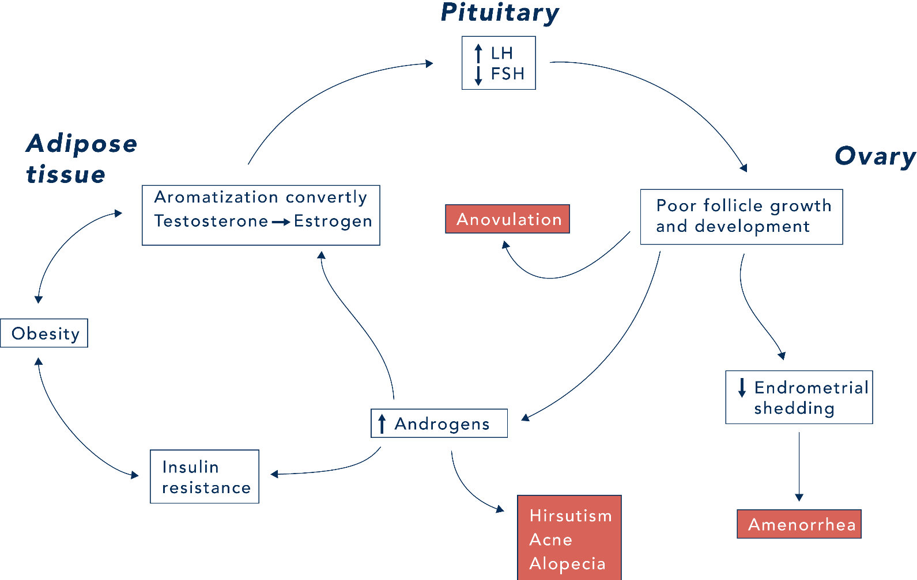
PCOS – Vicious cycle

Slide 14
PCOS and Miscarriage
Women with PCOS have a 2-fold increase of miscarriage after ART (IVF or IUI)
Chason et al. A Diagnosis of Polycsytic Ovary Syndrome (PCOS) is associated with an increased likelihood of pregnancy loss with Assisted Reproduction. October 2010
PCOS found in ~40% to 80% of women with recurrent miscarriage
Factors in women with PCOS that may be contributing to increased miscarriage rates include
Higher LH levels which can be increased by elevated insulin.
Elevated testosterone levels
Obesity
Insulin levels
Infertility treatments may also be involved
Palomba et al. Effect of preconceptional metformin on abortion risk in polycystic ovary syndrome: a systematic review and meta-analysis of randomized controlled trials. Fertility Sterility. 2009.
Notes:
PCOS and Miscarriage:
•Characterized by androgenism and irregular menses.
•Not only are women not able to get pregnant, but for sometimes the body is not able to maintain a pregnancy even if it's assisted in other ways.
•Not sure of mechanisms but probably due to elevated testosterone.

Slide 15
Treatment regimen for PCOS in Reproductive Health?
Preconception
Weight loss; 5-10% may initiate normal cycles
Ovulation induction: Clomid or Femara
Exercise: both Pre-conception and Gestational
Insulin sensitizing agent; Metformin, 1st Trimester
Per: Dr. Tyson clinical advice
Notes:
Treatment regimen for PCOS in Reproductive Health?
•Preconception counseling is the key to Obstetrics health to talk about their risk factors, modifiable risk factors, and set out a plan for them to modify those.
•Unfortunately, not many women receive preconception counseling, unless they are having trouble with infertility and/or have PCOS
•Prescribe a 5 to 10% weight loss to restore normal cycling,
•Prescribe exercise
•Prescribe Metformin to increase insulin sensitivity and reduce the circulating insulin levels; science behind continuing in pregnancy is less clear.
•Common to leave them on the Metformin through the first trimester if patient has a history of trouble getting or staying pregnant.
•PCOS women are also at risk for gestational diabetes. Many of them end up on metformin throughout the entire pregnancy. But the fertility docs in particular rule, recommend keeping them on during the first trimester.

Slide 16
Exercise, Weight Loss and Fertility
Women lost on average of 10.2 kg
60 of the 67 anovulatory subjects resumed spontaneous ovulation
52 achieving a pregnancy (18 spontaneously)
45 live births
The miscarriage rate was 18%, compared to 75% for the same women prior to the program
Clark et al. 1998
Notes:
Exercise, weight loss and fertility:
•Clarke et al. 1998 demonstrated that 5 to 10% of weight loss can improve fertility.
•Of the 67 anovulatory patients, 60 of them returned to normal cycling without medication to trigger their ovulation.
•52 got pregnant and then 45 got live births.
•Note: Considering that up to 25% of pregnancies overall in the world end in miscarriage, many of them before the woman even realizes she's pregnant, 45 live births out of 67 is a pretty good rate.
•18% miscarriage rate after the exercise program, compared to 75% prior to it.

Slide 17
Health Costs
Before program, the 67 women had treatment costing a total of $550,000 for two live births
$275,000 per baby
After exercise/diet/weight loss program, the same women had treatment costing a total of $210,000 for 45 babies
$4,600 per baby
Clark et al. 1998
Notes:
Exercise, weight loss and fertility: Significant Health Cost Savings
•Prior to program, the two pregnancies that were successful cost $550,000 to achieve. Over a quarter million dollars for each baby.
•Note: Just for women to get pregnant, carry the pregnancy, have the baby and then possible I don't know if they figured neonatal costs into that.
•After the program, total health cost was $210,000 and had 45 live births.
•Extrapolating that from 60 patients to hundreds of thousands across the country and a big savings in health care dollars could be achieved

Slide 18
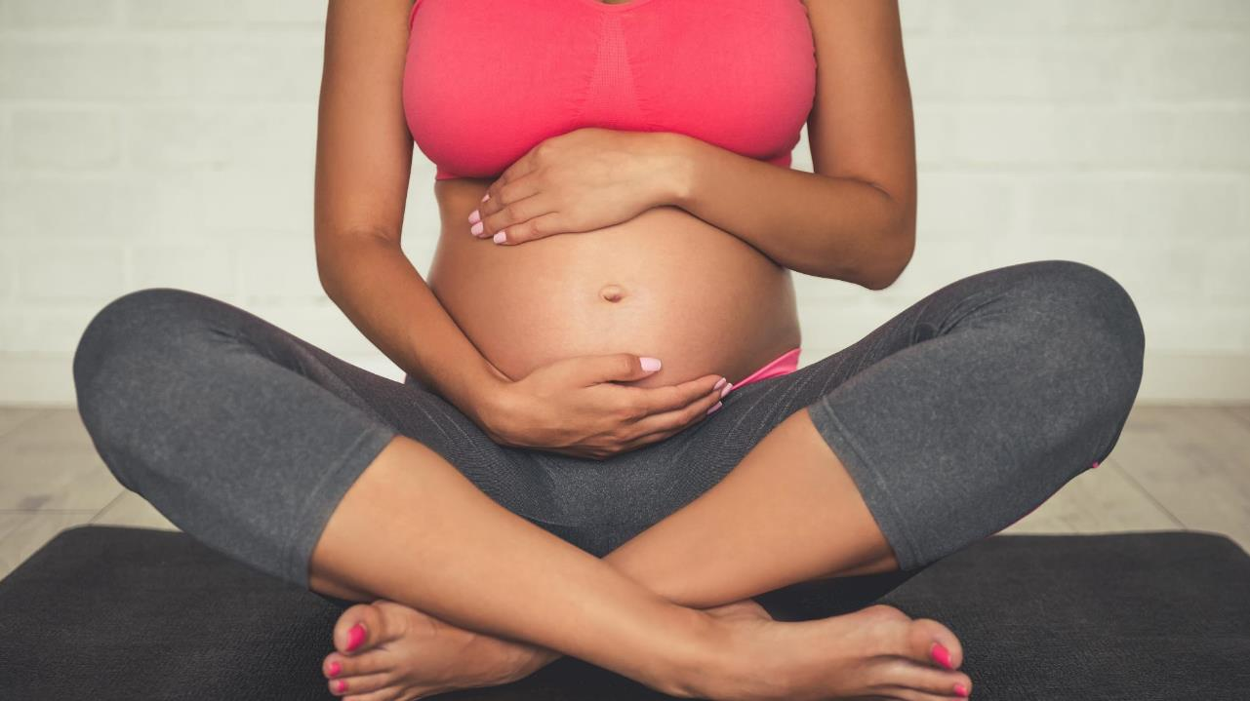
Pregnancy

Slide 19
Nutrition and Pregnancy
More protein, iron, calcium, and folic acid than before pregnancy; and more calories.
But "eating for two" doesn't mean eating twice as much.
Gain weight gradually, with most in the last trimester.
2 to 4 pounds total during the first trimester
3 to 4 pounds per month for the second and third trimesters
Most women ~300 calories a day more during at least the last six months of pregnancy than they did before they were pregnant.
Fetus needs healthy foods that are packed with nutrients - not "empty calories" such as those found in soft drinks, candies, and desserts.
https://www.acog.org/womens-health/faqs/nutrition-during-pregnancy
Notes:
Nutrition and Pregnancy:
•Non-image clinical tracking of normal births are based on weight gain and measurements.
•I.e. low weight gain or on low measurements can be confirmed that with ultrasound.
•A heavier woman needs to gain less weight than a thinner woman starting out.
•Not just about calories to build a human being:
•Skin and muscle. You need protein to build those things.
•What do you need to build bones? You're going to need calcium.
•You're going to have a lot of rapidly dividing cells to produce all the tissues of the body. You're going to need folic acid to do those things.
•Overall, about 2 to 4lbs each month during the first trimester and in 3 to 4lbs in the 2nd and 3rd trimester.
•It averages out (if you look at the 2nd and 3rd trimester) to about 300 calories a day increase.
•Equivalent to a snack like half a peanut butter sandwich.
•Needs to be nutrient dense food.
•If averaged that 300 calories a day during the second two trimesters, but averaged out for the entire pregnancy, it is equivalent to an increase of 150-180 calories per day for the whole pregnancy.
•Sugar, sugary foods, empty calories, things like that are still wants to be sparingly eaten, if at all.

Slide 20
Gestational Diabetes Mellitus
Female Pregnancy
https://www.acog.org/womens-health/faqs/gestational-diabetes
https://care.diabetesjournals.org/
Modifiable risk factors for GDM
Physical inactivity, obesity/overweight, previous GDM, and a history of macrosomic (> 4kg) babies
Women who are overweight have a 1.8–6.5 times greater risk of developing GDM than normal weight women
Between 15%-70% of women with GDM will develop type 2 diabetes later in life
It is likely that many women who have gestational diabetes are previously undiagnosed with type 2 diabetes
Notes:
Gestational diabetes.
•Technically, a woman who was a type 2 diabetic for years but never may be diagnosed with gestational diabetes.
•However, often rapidly determined between T2D and GDM because needs for medication or insulin are much higher in T2D; blood sugars don't respond as expected, etc.
•Classifications of each are beyond the scope of today’s lecture.
•Ways to avoid, or minimize, the effects of gestational diabetes.
•Unmodifiable risk factors:
•Age. The older women are when they get pregnant, the more likely they are to get gestational diabetes.
•Racial or ethnic predispositions.
•Modifiable risk factors:
•Physically inactivity, overweight/obesity, history of macrosomia (having had a large baby) in the past not assuming greater than 4 kg
•Women are at risk in a subsequent pregnancy to develop gestational diabetes.
•Clinical Pearls: with a large baby born in previous pregnancy, mother may have had a little bit of subclinical diabetes that wasn’t diagnosed.
•Pay more attention clinically with a subsequent pregnancy,
•Various studies demonstrate a range of 2 times to 6.5 times the risk of developing GDM.
•Clinical Opportunity: 50 to 60% of women who developed gestational diabetes then go on to become Type two diabetics later.
•Pathophysiology of gestational diabetes
•Human lactogen produced by the placenta starts to rise after about 24 weeks of the pregnancy, and peaks somewhere in the early thirty's weeks.
•Human placental lactogen acts as an anti-insulin. Rationale is evolutionary when nutrition and calories weren't as abundantly available as they are now. When people had to grow or hunt their own food, the human body said, “well, we need to have a lot of sugar available for this Mom, have energy while she's growing the baby. Lactogen hormone allows mother to be provided with more sugar. Now with abundance of calories, see gestational diabetes popping up because of this abundance of food. So it does give you a kind of a preview again.
•HpL is an insulin resisting hormone. 10 years after the pregnancy, when there is no more human placental lactogen, and possibly woman gained weight. So then there's more insulin resistance due to the fat. Age affects it. So it's one risk factor that can show you the terrorist have insulin resistance and therefore developed diabetes later.
•Clincal Opportunity #2: Test mother six weeks after their delivery with a glucose tolerance test just to be sure that woman isn’t still diabetic or persistent in diabetes.

Slide 21
Gestational Diabetes Mellitus (GDM)
Normal pregnancy
Placental hormones (estrogen, cortisol and lactogen) contribute to insulin resistance at the muscle level
Ensures adequate glucose supply for fetal growth and development
https://www.ncbi.nlm.nih.gov/​
Notes:
Normal pregnancy placental hormones the contribute to insulin resistance at the muscle contributes to fetal growth and development.

Slide 22
Gestational Diabetes Mellitus (GDM)
In the 2nd (13-28 weeks) & 3rd (28-40 weeks) trimesters, hormones produced in excess, resulting in further insulin resistance
When pancreas cannot meet increased insulin demand and if risk factors (genetics, nutrition, obesity, sedentary behavior) for GDM are present, results are hyperglycemia, hyperinsulinemia and GDM
https://www.ncbi.nlm.nih.gov/​
Notes:
Continue discussion

Slide 23
Symptoms and Signs of GDM
Unusual thirst
Sugar in urine
Polyuria
Fatigue
Nausea
Blurred vision
Bladder/vaginal infections
Most often asymptomatic
Notes:
Signs and symptoms of gestational diabetes the same was for diabetes in any new presentation.
•Polyuria, polydipsia, or polyphagia (this one doesn't usually happen).
•Most of them are just asymptomatic,
•Clinical Opportunity: Urine dip to look for protein and sugar, looking for pre-eclampsia and gestational diabetes.
•Screened on a routine basis; sometimes the first clue for GDM.

Slide 24
Effects of GDM on Mother
Hypertension
Gestational hypertension and proteinuria
Pre-eclampsia
Increased risk of cesarean delivery
Notes:
Effects of GDM on Mother:
•Women with GDM have geater risk to develop hypertension.
•Preeclampsia and gestational hypertension.
•Difference between the two is presence of protein in the urine.
•They may be the same disease just expressed slightly differently or different points along a continuum. But the gestational diabetic sort risk for both of those things.
•They're also risk for requiring C-section.

Slide 25
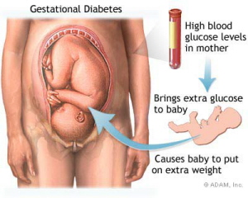
Gestational Diabetes Mellitus (GDM)
Effects of Glucose https://www.ncbi.nlm.nih.gov/
Maternal hyperglycemia results in:
Excessive growth of fetus and birth weight (macrosomia: > 4kg)
Disproportional (larger shoulders than head) which may result in difficult labor and delivery, shoulder dystocia and potential cesarean section delivery
Babies with fetal hyperinsulinemia in response to excess maternal glucose diffusing into fetal blood
Notes:
Maternal Hyperglycemia Results:
•Macrosomia > 4kg at birth
•Baby also mal-proportioned. The trunk and the shoulders grow larger relative to the rest of the body, leading to shoulder dystocia, where the baby's head delivers and then the shoulders get stuck.
•The shoulder in front, usually gets caught behind the mother’s pubic bone, and this is an obstetrics emergency.
•Doesn't always result in a C section but it does result in a lot of immediate emergency maneuvers to try to deliver the baby and can result in some damage to the baby, even neurological if we can't get them out fast enough.
•Mother with persistent hyperglycemia is transferred to the fetus is receiving nutrients through the placenta and the umbilical court
•Fetal glucose delivery is therefore persistently high. Baby’s pancreas increases insulin secretion to deal with the hyperglycemia.
•When baby is delivered and umbilical cord is cut, there's no longer this exogenous source of sugar delivering to the baby.
•Pancreas does not immediately turn off insulin production
•High levels of circulating insulin can cause undetectable low blood sugars like zero on the heal stick.
•Resulting hypoglycemia at birth then requires intravenous glucose supply.

Slide 26
Gestational Diabetes Mellitus (GDM)
Effects of Glucose https://www.ncbi.nlm.nih.gov/
Complications
Fetal and Perinatal mortality
Congenital malformation
Neonatal hypoglycemia (BG< 40 mg/dl in first few days after birth)
Hyperbilirubinemia (elevated bile pigment)
Polycythemia
Hypocalcemia
Respiratory distress syndrome
Notes:
Other GDM complications to the baby:
•Diabetic moms are also at risk to have babies whose lungs don't develop as fully.
•Anatomically their normal but the surfactant that keeps the lungs open doesn't develop as well.
•Diabetic mom is more likely to have a baby with respiratory distress syndrome than a non-diabetic mom.
•Needs to be taken into clinical consideration when deliveries are planned.
•Baby also at risk for hyperbilirubinemia (which in the modern world isn't that much of a problem anymore; effective treatments is UV light); can be a problem if left untreated.
•Babies are also born with polycythemia; too much blood there and high hemoglobin concentration; a diabetic baby it could be at HCT 60 65%.
•Too concentrated blood trying to pump through the vascular system. .

Slide 27
Screening and Diagnosis
Screening for GDM is done between 24-28 weeks in low-risk pregnancies
Screening should be done earlier in higher-risk pregnancies (patients who are obese, twin gestations)
Patients drink a 50-g glucose drink (non-fasting)
Those with serum glucose 140 or higher after one hour go on to a diagnostic test
Notes:
Screening for GDM:
•Glucose levels start to rise in the 2nd and 3rd trimester after about 24 weeks or before 28 weeks.
•In-office GDM screening procedure: Woman drinks a 50 g sugar load; does not need to be fasting. After one hour, we test their blood sugar is tested. If it's 140 or above, we know they're at risk for gestational diabetes.
•Clinical Opportunity: Women who have preexisting obesity, mom who has multiple gestation twins, triplets or greater, who has had gestational diabetes before, doctor might consider screening them at the very first prenatal visit, even if it's in the first trimester. You're not screening for gestational diabetes at that point but you're screening for preexisting Type two diabetes.

Slide 28
Oral Glucose Tolerance Test
Tolerance Test
Medindia.net
3-hour Oral Glucose Tolerance Test, OGTT, GTT (serum, plasma)
UNITS | FASTING | 1 HOUR | 2 HOUR | 3 HOUR
Mg/dL | 95 | 180 | 155 | 140
mmol/L | 5.3 | 10 | 8.6 | 7.8
http://www.perinatology.com/Reference/Reference%20Ranges/30GTT.htm
Notes:
Diagnosis Tool: Oral Glucose Tolerance Test (OGTT):
•If the women screened positive with at 140 or greater than they go on to perform a three hour OGTT.
•Come into office fasting where a fasting BG is taken. Woman then drinks 100 gram load of sugar, BG is tested at 1, 2, and 3 hours.
•Two values above the thresholds noted gives the diagnosis of gestational diabetes.

Slide 29
Exercise and Nutritional Therapy for GDM
Goal is to achieve normoglycemia, prevent ketosis, provide adequate weight gain, and contribute to fetal well-being (ACOG)
Nutritional counseling with RD
Caloric allotment and macro-distribution
CHO of 30-40% (>50% results in excessive weight gain and can result in post-prandial hyperglycemia)
Complex carbohydrates
PRO of 20%
FAT of 30-40%
https://www.ncbi.nlm.nih.gov/pmc/articles/PMC6413112/
Notes:
Nutritional Therapy for GDM:
•First line treatment for GDM (as for diabetes outside of pregnancy) is nutrition and exercise.
•Nutritionists are key.
•Understanding the SES and SDOH of patients are key.
•Women from lower social economic groups may not have the same access to food as those with high SES.
•SDOH: The food they do have access to maybe sort of cheap, low quality food. And so it's a multifactorial problem.
•Don’t want to cut out carbohydrates; woman needs the energy to function during the day and build a baby. But don’t want excessive carbohydrates.
•Aiming for 30-40% of the calories coming from carbohydrates
•Mother needs complex carbohydrates (whole grains, fruits, and vegetables) not simple carbohydrates (white bread, plain rice, etc).
•Aiming for 20% of calories coming from protein (remember, you're building a person, add placental tissue, and the uterus has to grow.)
•Aiming for 30-40% of calories from fat (building a brain).

Slide 30
Exercise and Nutritional Therapy for GDM
Three main meals with at least two nutritious snacks
Distributes glucose intake and reduces PPG spike
Exercise
Maintains lean muscle quality and quantity
Improves muscle tissue sensitivity to insulin and glycemic control
Has not been shown to prevent development of GDM
https://www.ncbi.nlm.nih.gov/pmc/articles/PMC6413112/
https://journals.lww.com/clinicalobgyn/Citation/2003/06000/Canadian_Guidelines_for_Exercise_in_Pregnancy.27.aspx
Notes:
Nutritional Therapy for GDM:
•Recommend a normal eating schedule with 3 main meals and 2 nutritious snacks.
•Nausea and vomiting throws off the normal schedule many times; watch for first trimester minimalist “eating” i.e. was ginger ale and white bread that is not nutritious.
•Fear of being sick sometimes keep women from going back to normal diet. Must work with mother to get her eating well again.
Exercise Therapy for GDM: Diet alone isn't enough.
•Maintain and increase lean muscle mass, so you increase the calorie and carbohydrate usage.
•Improve muscle sensitivity to insulin, which helps you to regulate your overall blood sugar.
•NOTE: Somewhat contradictory, GDM not prevented with exercise alone.
•Could be a pre-existing condition of T2D that was diagnosed as GDM.
•Though exercise alone cannot prevent GDM, it can moderate GDM effects.
•Can get better blood sugar control and moms who exercise compared to moms who don’t.
•Can also moderate weight gain during the the pregnancy, which helps to break that cycle of insulin resistance due to too much adipose tissue.

Slide 31
HTN and Preeclampsia
High Blood Pressure During Pregnancy | cdc.gov
Maternal HTN: > 140/90 mmHg
Preeclampsia: New HTN with onset after 20 wks + proteinuria
Incidence of 3–7%
Causative of potentially lethal complications including abruptio placentae, cerebral hemorrhage, hepatic failure, acute renal failure.
Also associated with increased risk for cardiovascular disease in the future
Patient Screening
Notes:
Hypertension (HTN):
•Hypertension in a pregnant woman is diagnosed or defined the same way as hypertension in a non pregnant patient.
•Systolic Blood Pressure (SBP) of 140 or greater, and/or diastolic of 90 or greater.
•For diagnosis, must occur two separate times, at least 4 hours apart.
•If > 140/90 in the clinic, one day, usually have mother come back a day or two later and check it again jus to try to catch it earlier.
•Gestational hypertension is hypertension occurring after 20 weeks of pregnancy and it does not include proteinuria.
Preeclampsia: This subset of hypertension can cause renal failure or hepatic failure. It can kill women, so it really is something to pay a lot of attention to.
•Preeclampsia is new onset of hypertension after 20 weeks of pregnancy with the component of proteinuria, due to renal damage from hypertension.
•Protein that normally would not pass through the glomerulolous into the urine that is now passing through and coming out in the urine.
•The premier is a marker of actual renal function or dysfunction.
•All hypertensive disease in pregnancy is bad.
•The maternal brain is more sensitive to changes in pressure, the capillary beds in the brain or more fragile during pregnancy.
•Women in pregnancy stroke at much lower blood pressures than non-pregnant women.
•i.e. a chronic hypertensive patient might come into the ER with blood pressure of 210/125. They don't even blink. They just given anti hypertensive and tell her to go home.
•That same patient but pregnant comes into clinic, and its an emergency. She immediately gets a quick release Oral anti hypertensive and an ambulance ride to the hospital because she urgently needs her blood pressure brought down.
•Stroke is increasing in women of reproductive age (both thrombotic and hemorrhagic strokes) due to hypertension becoming more common in younger women.

Slide 32
Preview to patient health risks later in life
Preeclampsia predicts CVD later in life
GDM predicts Type 2 Diabetes
Cellular dysfunction for years, that finally manifests as chronic disease symptoms.
Notes:
In a nutshell, gestational diabetes predicts Type two diabetes and preeclampsia predict hypertension.
Also, mothers who have pre preeclampsia are at greater risk to have other cardiac disease later in life, like hypertension again, mi’s and strokes.

Slide 33
Associations with Preeclampsia
Hypertriglyceridemia
Excessive lipid peroxidation
Antioxidant deficiency
Insulin resistance
Plasma elevations of proinflammatory cytokines and C-reactive protein
Hyperhomocysteinemia
Hyperleptinemia
Thromboxane-prostacyclin imbalance that favors vasoconstriction
Women who are pregnant experiencing anxiety and/or depression are at a threefold increased risk of preeclampsia
Notes:
Associations with Preeclampsia (Reminder that association is not causation).
•In a preeclamptic patient other issues are seen such as
•Excessive triglycerides, excessive amounts of lipid peroxidation, antioxidant deficiencies, insulin resistance, elevated levels of leptin.
•Tthromboxane-prostacycline imbalance favors vasoconstriction, which may be a plausible method by which preeclampsia develops.
•Women who have anxiety or depression have a much higher risk of preeclampsia (cause not yet known).
•Clinical Pearls: Studies demonstrate that you can reduce a woman stress and pregnancy by doing group prenatal care, with increases social support.
•Comparing women who were in group prenatal care to those who were not in group prenatal care demonstrating different levels of stress markers.

Slide 34
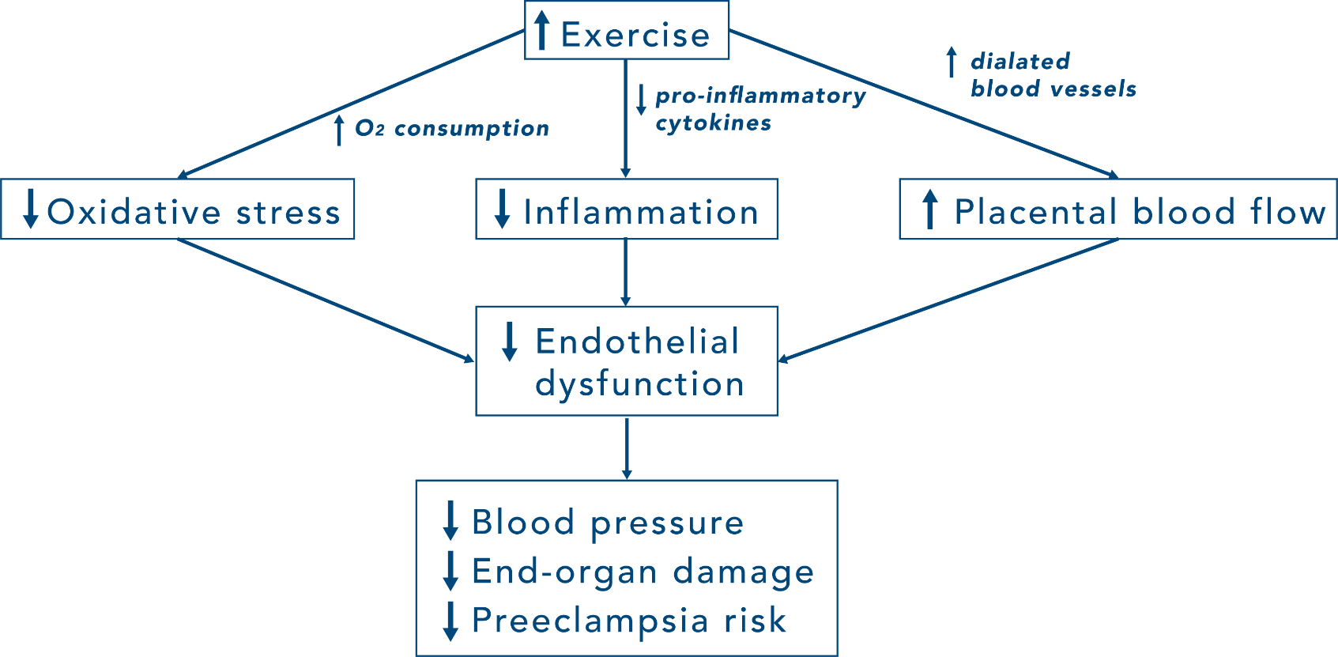
Potential mechanisms by which exercise training reduces preeclampsia risk
Genest D S et al. Hypertension. 2012;60:1104-1109
Copyright © American Heart Association, Inc. All rights reserved.
Notes:
Potential mechanisms by which exercise training reduces preeclampsia risk:
•Preeclampsia is characterized by systemic endothelial dysfunction induced by inflammation, oxidative stress, and placental abnormalities.
•Gray box with solid lined arrows, preeclampsia-promoting entity;
•White box, effect of exercise training;
•Dotted line arrows, reduction of identified preeclamptic pathway by exercise training. HTN indicates hypertension; CVD, cardiovascular disease; TLR, Toll-like receptor; TNF, tumor necrosis factor; IL, interleukin.
Potential intermediate effects include:
•reduced blood pressure, decreased concentrations of proinflammatory
•cytokines and leptin in peripheral circulation,
•reduced oxidative stress, and improved plasma lipid and
•lipoprotein concentrations
Clinical mechanisms of preeclmpsia are not known, but clinical presentations are:
•Capillary leak due to endothelial dysfunction, measured markers of chronic inflammation, abnormal placentas including infarction in the placenta, vascular changes, and signs of athlersclerosis in the placenta.
Treatments to reduce risk of Preeclampsia:
•Reducing circulating pro-inflammatory cytokines can reduce the inflammation, which in turn reduces endothelial dysfunction, which in turn reduces risk of preeclampsia.
•Exercise raises circulating antioxidants, which reduces stress, which reduces endothelial dysfunction.
•Exercise reduces obesity and reduces hypertension. Clinical observations.

Slide 35
Should PA be Evaluated as a Nonpharmacological Therapy for Women with Hypertension/Preeclampsia in Pregnancy?
Exercise therapy has been shown to result in reduced diastolic blood pressures in women who are pregnant with a history of mild hypertension, gestational hypertension or family history of hypertensive disorders
Preeclampsia is an absolute contraindication to exercise during pregnancy re: ACOG
Notes:
Thoughts: Can physical activity as therapy for women with hypertension and preeclampsia?
•We know mechanisms for exercise to reduce hypertension, particularly diastolic blood pressures in pregnant women who have had mild hypertension or gestational hypertension
BUT
•Preeclampsia is an absolute contraindication to exercise.
•Because preeclampsia is unstable hypertension that changes rapidly
•Preeclampsia is highly vasoactive in nature; if vasospasm is already occurring and then adding catecholamines produced through performing exercise can worsen vasospasm, increase hypertension, and significantly increase risk to the maternal brain.
•Once patient is diagnosed with preeclampsia, they must stop exercising.

Slide 36
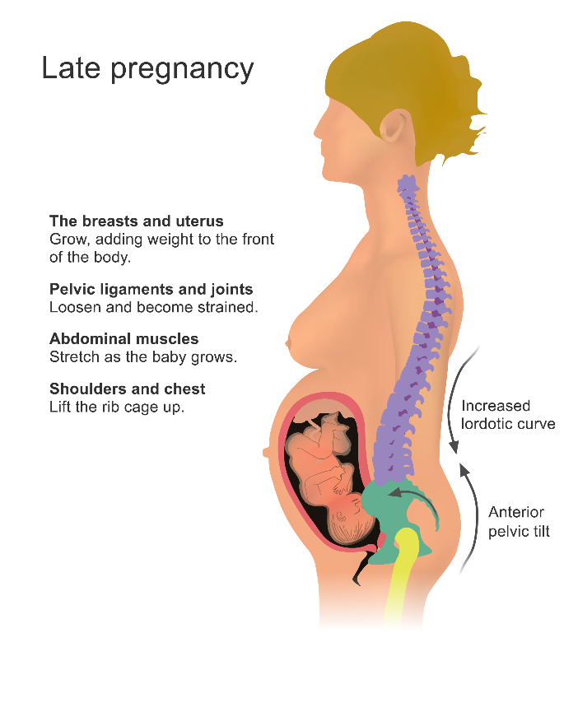
Low Back Pain
Clinical Discussion per: Dr. Tyson
50-90% of women who are pregnant experience back pain during pregnancy
Increased biomechanical strain and altered hormonal influences
The sacroiliac joints often loosen and become strained
Abdominal muscles stretch and become weak as baby grows
Nerves may be pressed during fetal growth
Obesity, in relation to maintained maternal weight gain, may also influence chronic musculoskeletal disease risk related to low back pain, and hip and knee osteoarthritis
Notes:
Other Co-Morbidities to Exercise - Low Back Pain:
Many normal physiologic adaptations occur in pregnancy to cope with getting through pregnancy, as well as labor and delivery; however they also can create pathology and physical discomforts.
•One of the most common complaints seen in clinic is low back pain.
•50 to 90% of women present for care for back pain. All women going to have back pain at some point during the pregnancy.
•Contributors:
•Change in shape and distribution of weight (more centered on the abdomen); adding the weight of the uterus, the additional blood, and fetus all to the abdomen and specifically to the front of the abdomen.
•Body wants to maintain an erect posture and to keep the body in balance; therefore, to compensate, body arches backwards.
•Arch increases the lumbar spine lordosis, and walking this way becomes unnatural
•Body compensates by adjusting the stance of the gate, becomes a wider based gate, and the motion initiating walking isn't necessarily the flexion of the thigh upon the hip, it's almost like a swinging motion.
•So by the time a woman is 40 weeks pregnant she's swinging her legs when she walks, using smaller muscles to do the work that big muscles normally do, and with an abnormal posture.
•Using muscles in different ways than they are accustomed to causes fatigue and muscle strained fatigue that can lead to injury.
•The SI joints become involved that causes low back pain that comes from inflammation at the SI joint from cartilage and the bone rubbing together.
•In pregnancy, more movement at the SI joint can get exacerbated and create pain
•Women already obese at pregnancy where baby weight is added, increases the potential for muscular strain, weight burying on both the hips and the knees, which are very fragile joints and can create pain at all of these locations.

Slide 37
Exercise and Low Back Pain
Backpain Exercises
International Journal of Childbirth Education
Increased biomechanical strain should be considered in exercise prescription, especially in individuals performing high impact exercise
Water exercise during the second half of pregnancy significantly reduces low back pain intensity
PT with guided stabilization exercises demonstrated greater positive effect on postpartum pelvic girdle pain compared to a program without stabilization exercises
NO supine resistance exercise after first trimester
Notes:
Exercise and Low Back Pain:
•Exercise in pregnancy is important to reduce previously mentioned co-morbidities, but need to keep in mind the physiologic limitations and changes occurring as stated in the previous slides.
•Water exercises are great to reduce mechanical strain through taking weight off the joints.
•PT with guided stabilization is important
•NOTE: No supine resistance exercise after first trimester.
•Rationale: the uterus gets bigger, the weight of the uterus compresses the vena cava in a supine position.
•When the vena cava is compressed, get less venous blood flow returning to the heart, and get “supine hypertension syndrome.”
•Women who lay down flat can faint as they are not getting enough blood returning to their heart.
•Sciatica also common in pregnancy.
•Hamstring stretches help; stretching the glutes may also help prevent some back pain because they become more engaged in the walking and tend to fatigue faster.

Slide 38
Pregnancy-Related Urinary Incontinence
Pregnancy-related UI is a debilitating, chronic issue
Issues of labor and delivery are most frequently cited
nerve injury (including lumbar nerve root, lumbosacral plexus, and peripheral nerves, in particular pudendal)
soft tissue injury related to rapid fetal descent and episiotomy
While exercise and physical activity may have no impact on features of labor and delivery related to UI, physical fitness level may have some impact on maternal pushing ability
Prolonged pushing has been associated with nerve injury
Notes:
Pregnancy-Related Urinary Incontinence:
•Incontinence can become an issue, and it could be a real problem.
•It can be chronic and less resource in low resource countries.
•Problems occurring in labor and delivery may contribute to it later on in life and in the postpartum period.
•Some factors related to the baby moving down through the pelvis if it sits in the mid pelvis to the low pelvis. If long enough, woman can actually get compression on the sacred plexus.
•Prolonged pushing seems to have the biggest influence on chronic postpartum incontinence.
•If there is a significant obstetrics laceration at the time of delivery, patient can have damaged to the pelvic floor muscles, which can contribute to incontinence later on.
•Maternal physical fitness may affect the mother’s ability to push.
•Higher levels of fitness enable moms to push more effectively and more efficiently.
•Subsequently spend less time with the baby's head compressing the nerves and compressing the pelvic floor, potentially damaging the muscles.

Slide 39
Pregnancy-Related Urinary Incontinence
Degree of risk attributable to delivery mode is unclear
Some studies show that cesarean delivery is not protective against UI
Notes:
Pregnancy-Related Urinary Incontinence:
•Studies demonstrate that women who believe that it is important to have a C section to (for various reasons) will not have urinary incontinence later on in life; this is false.
•It seems to be the pregnancy itself; cannot necessarily prevent urinary incontinence with a C section.

Slide 40
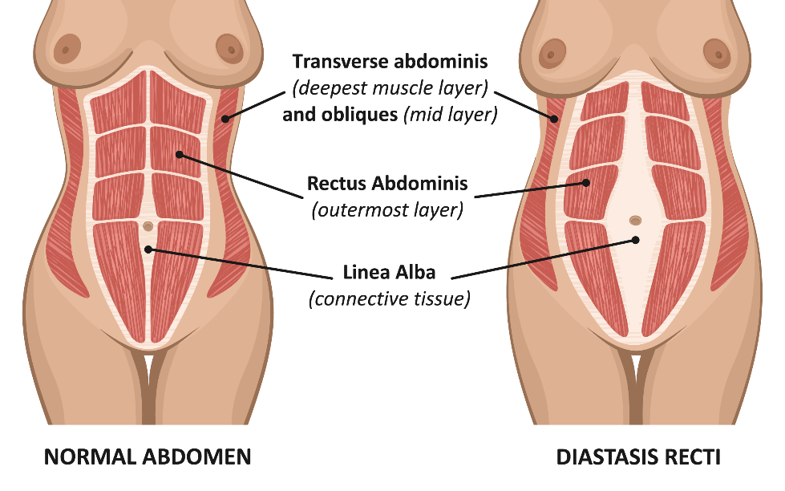
Diastasis of the rectus abdominus muscle from the linea alba
Diastasis Recti
Incidence as high as 67%
Unknown whether specific PA performed in pregnancy or postpartum can prevent or reduce abdominal muscular separation
https://www.sciencedirect.com/science/article/abs/pii/S1356689X14001817
Notes:
Diastasis of the rectus abdominus muscle from the linea alba:
•Normally the rectus muscles travel straight downward from the lower part of the rib cage straight down to the symphysis pubis.
•As the abdomen grows, the fascia of the abdomen rector fascia and the transverse sub dominance fascia stretch out.
•Minimum of 1 cm and up to six- or eight-centimeters space between the muscles.
•Muscle bowed out in that fashion makes it less efficient in its ability to contract.
•The rector abdominals are actually the first muscle that you use when one stands up to stabilize the trunk and pelvis in order to stand.
•Rectus contracts, and then one extends at the thighs and hips to stand.
•As pregnancy proceeds the diastasis gets wider
•It is a problem of appearance but also affects mobility.

Slide 41
Exercises that increase intra-abdominal pressure can worsen diastasis
Avoid these Exercises
http://pregnancyexercise.co.nz
To prevent and heal a Diastasis recti-post pregnancy, avoid exercises that can increase the gap between the two sides of the rectus abdominis muscle
Exercises to Avoid:
All abdominal crunches
Pilates, frontal planks, or any core exercises that increase intra-abdominal pressure
Oblique twists
Reverse leg lowers
Notes:
Exercises that increase intra-abdominal pressure can worsen diastasis
•To prevent diastasis, do not perform any exercises that increase the intra-abdominal pressure that would then push out the abdominal contents more.
•I.e.: crunches, the one hundreds from Pallotti's, prolonged planks, or anything like that that's going to push out the abdomen.

Slide 42
Musculoskeletal Conditions of the Lower Extremity
Ligamentous laxity may be associated with lower extremity injury
ACL laxity
Labrum of the hip or meniscus of the knee may be at greater risk of injury in the setting of ligamentous laxity
Relaxin-related dissociation of large collagen fibrils thought to be causative
Can cause “locking” of the knee joint
Clinical Discussion per: Dr. Tyson
Notes:
Musculoskeletal Conditions of the Lower Extremity
•The pelvis, which is a fairly fixed series of bones, has to accommodate a baby (or babies) passing through it and delivering.
•As mentioned, mother gets motion in the SI joint and synthesis pubis in pregnancy.
•SI joint actually like the wings of the pelvis kind of open up like a book.
•The synthesis pubis accommodates that as well.
•Relaxin is released in the third trimester, that softens the cartilage in the joints and gives that flexibility and lets the sacrum drop a little bit to accommodate the baby coming through.
•Relaxin is not specific, so it also will soften the cartilage in the lumber spine and the arms, legs, specifically the knees, so they can predisposed to injuries such as ACL tears and lumber disk damage (not common but prone).

Slide 43
Musculoskeletal Conditions of the Lower Extremity
Avoid Third Trimester High Impact Exercises
Women should avoid third trimester high-impact exercise
Women who are pregnant with normal lumbar and femoral bone density can have bilateral sacral stress fractures were related to fatigue fracture due to unaccustomed loading in the last trimester
Running
Clinical Discussion per: Dr. Tyson
Notes:
Musculoskeletal Conditions of the Lower Extremity
•Advise women to avoid high impact exercises in third trimester
•Even previous runners, etc. develop stress fractures and muscle fatigue.
•Consider modifying exercise during pregnancy because:
•(A) carrying more weight.
•(B) carrying it in a different way and
•(C) the body is not as rugged for weight bearing exercise.
•Take home: exercise pre pregnancy may become riskier during the pregnancy.

Slide 44
Maternal Physical Activity-Effects on Postpartum Weight Loss
15–20% of women ~5 kg heavier at 6–18 months postpartum than they were before pregnancy
Affects health later in life
Affects subsequent pregnancies
Women who lost their pregnancy weight by six months postpartum
gained 2.4 kg in the following 8.5 yr, compared to an 8.3-kg gain in women who did not lose pregnancy weight
women with the smallest weight gain breastfed their infants for longer than 12 wk or participated in aerobic exercise
Notes:
Maternal Physical Activity-Effects on Postpartum Weight Loss
•Losing baby weight and getting body back is a big topic.
•Most women gain weight during pregnancy, and many women keep some portion of that weight after pregnancy.
•People in USA tend to gain weight as they grow older. It's additive weight over time..
•Keeping body weight from previous pregnancy increases risk in the subsequent pregnancy.
•Weight loss methods:
•Women who breastfeed actually returned to their pre pregnancy weight more quickly.
•Women who return to pre-pregnancy are less likely to gain more weight.
•Women who had the smallest gestation weight gains subsequent to the pregnancy were ones who either breast fed for greater than three months or who participated in aerobic exercise. Exercise can help you restore normal body composition.

Slide 45
Maternal Mental Health
During pregnancy: fatigue, anxiety, and somatic complaints
Post-partum: negative mood symptoms, emotional reactivity, depression and/or anxiety
Psychosocial factors—weight gain, body image, maternal stress and worry, sleep difficulties, change in routine, perceived lack of control, changing role functions
Notes:
Maternal Mental Health
•During Pregnancy
•When women are pregnant, they become tired because they're not sleeping well, necessarily.
•They're doing a different kind of physical activity.
•They're stress and anxiety related with the health of the pregnancy, “Am I going to have a normal baby? Is everything going to be okay? What's going to happen in my family or how are things going to be different once the baby comes?”
•Minor aches and pains of pregnancy, which has caused stress over time.
•Postpartum, every woman gets “baby blues” to some degree; however, postpartum depression or even postpartum psychosis.
•Part of it's hormonal.
•Part of it has to do with stress of family dynamic changes(i.e. first baby causes , it's a radical change in lifestyle; second baby, and suddenly it's really different).
•Woman's body image changes.
•Role at her family may change (she may go from being the youngest daughter to now being a mother, and that's a different role in the family).
•Worry about their partner during the pregnancy, “Is my partner going to support me?”

Slide 46
Exercise and Mental Health
Strong scientific evidence that exercise during pregnancy
Increases vigor, improves body image and self-esteem
Helps to prevent and treat mild to moderate depression, anxiety, insomnia, reduces fatigue
Symptoms of depression and anxiety found to be lower in women who are pregnant and reported being physically active
Moderate physical activity during the third trimester has been associated with lower depression scores 6 weeks postpartum
Notes:
Exercise and Mental Health
•Exercise in pregnant women can increase their physical stamina, improve body image, improve self-esteem.
•Helps to prevent and treat mild depression, certainly moderate depression somewhat.
•Reduces the insomnia and fatigue partly because they're in better condition to deal with the load bearing of pregnancy and partly because they sleep better cause they're tired from insomnia.
•Moderate physical activity, moderate being walking, stationary cycling, or something that doesn't involve a lot of high impact has been associated with less risk of depression at six weeks post-partum.

Slide 47
Maternal Recreational Exercise and Offspring Health and Development
Observed Fetal Outcomes
No increase in clinical incidence of miscarriage, premature labor, premature separation of placenta, or malformation
Normal stress responses to exercise, normal growth, normal amniotic fluid erythropoietin levels
Women who continued vigorous weightbearing exercise until onset of labor
Fewer worrisome fetal heart patterns during labor
Decreased rates of both meconium staining and cord entanglement at birth
Notes:
Maternal Recreational Exercise and Offspring Health and Development
•Maternal exercise may affect not just baby’s health at delivery but also baby's risk for obesity later in life.
•No increase in the clinical incidents of miscarriage, no increase in preterm labor.
•Normal levels of the stress hormones that you would see in response to exercise.
•Babies usually grow normally, have normal intrauterine growth, they have normal amniotic fluid with reporting levels.
•Women who continued to exercise actually have fewer changes that are concerning their baby's heart rates, and they have decreased rates of meconium staining {a marker for fetal stress) and cord entanglement.
•Take Home: Babies do just fine with exercise as long as it is done with moderation and thoughtfulness care.

Slide 48
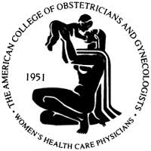
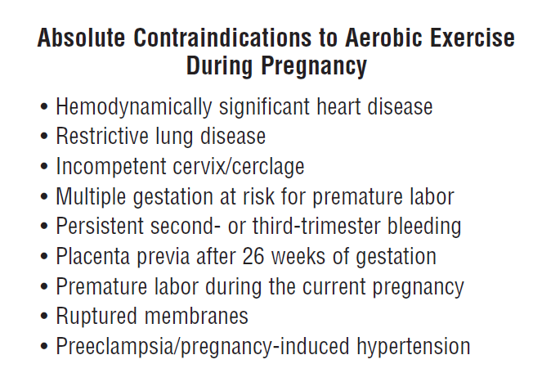
Absolute Contradiction to Aerobic Exercise
Notes:
Absolute Contradiction to Aerobic Exercise
•ACOG recommendations

Slide 49
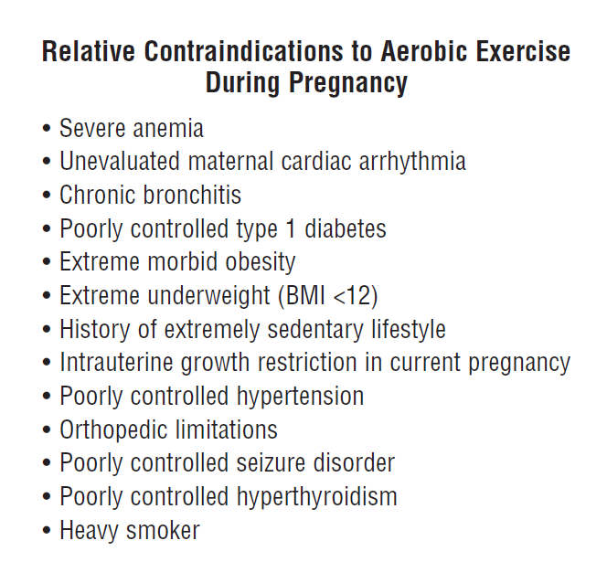
Relative Contradiction to Aerobic Exercise
Notes:
Relative Contradiction to Aerobic Exercise
ACOG recommendations

Slide 50
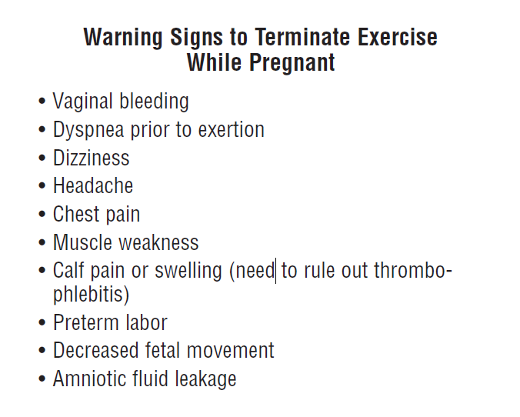
Relative Contradiction to Aerobic Exercise
Notes:
Warning Signs to Stop Exercise When Pregnant
ACOG recommendations

Slide 51
A “Common Sense” Approach
OK: jogging, brisk walking, cycling, strength conditioning exercises, yoga and swimming
Aim for at least 30 minutes exercise on at least five days a week
Aim to keep fit rather than reach peak fitness
If women exercised regularly before pregnancy, they should be able to continue with no adverse effects
If women have not exercised routinely, they should begin with ≤15 min of continuous exercise, 3X/week, increasing gradually to daily 30-min sessions
Notes:
A “Common Sense” Approach
•Tailor to your patient's needs. What is she starting from? What did she do prior to pregnancy? What are her goals for during the pregnancy?
•Generally early in the pregnancy, a little bit of light running walking is good.
•Cycling as a mother get further along into pregnancy, she may stop the bicycle to decrease fall risk.
•The recommendation for a pregnant woman is the same for a non-pregnant woman as per the U. S. Preventive Services
•Everybody should exercise at least 30 minutes a day, at least five days a week. Recommendation doesn't change.
•Just need to modify kind of activity and the intensity to maintain rather than increase fitness
•New exercisers should start slow and gradually increase exercise duration, intensity.

Slide 52
?
Practice Question 1
select one
A 32-year-old woman and her husband present to the woman’s gynecologist after 8 months of failing to conceive. The woman’s BMI = 41 kg/m². She is sedentary most of the day in her lifestyle and occupation. Which of the following is the most likely reason this woman cannot conceive?
Increased luteinizing hormone
Decreased vitamin D consumption
Decreased circulating insulin
Increased ovulation rates
Increased Vitamin D consumption

Slide 53
?
Practice Question 2
A married couple presents to a fertility specialist for having trouble conceiving after 6 months. The woman (37-years-old) is overweight (BMI= 26 kg/m²) and the man (39 years-old) is clinically obese (BMI = 34 kg/m²). Laboratory tests reveal that the infertility is male factor. The physician counsels both of them to begin an exercise program and for the man to lose at least 10% of his body weight. Which of the following will most likely occur due to the lifestyle modification to improve this man’s fertility?
select one
Hypogonadism
Hyperoxia-induced apoptosis
Decreased obesogens
Decreased activity of the HPT axis

Slide 54
Thank You

Slide 55
Image Documentation
Double click to view image documentation

